Slide 1
Vietnam Energy Future – Power Development Plan 8 – How to get deals done
DR. OLIVER MASSMANN - Partner, General Director
DUANE MORRIS VIETNAM LLC

Slide 2
Vietnam 2021 Economy at a glance
GDP: US$220.5 billion
GDP per capita: US$3,743
GDP Growth: 2.58% (despite national lockdown due to Covid-19)
Inflation: 1.84% (lowest since 2015)
Population: About 97.4 million
Total export and import turnover : US$ 288.14 billion (increase by 22.6% compared with 2020)
Regional Minimum wage (Region I): VND 4,729,400 (US$ 203.9) per month (Jan 2021)
Vietnam’s average age: 30.9 years old

Slide 3
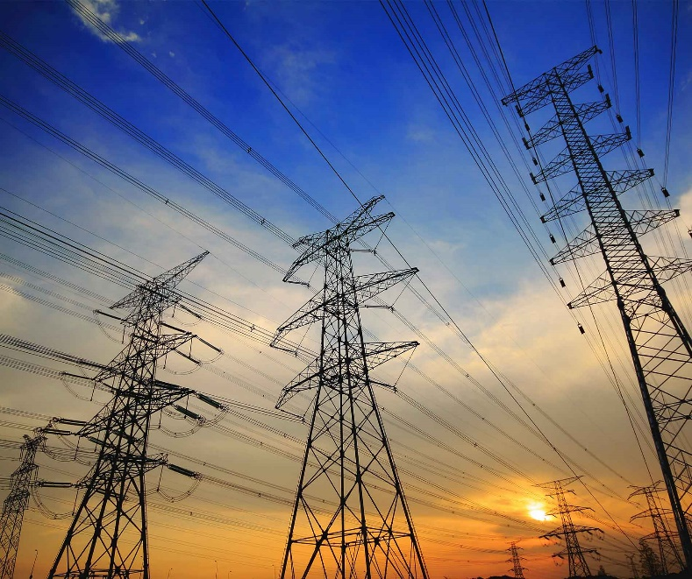
Energy Sector Background
The Institute of Energy has calculated that commercial electricity will reach 491 billion kWh by 2030, and 877 billion kWh by 2045
By 2030, the total installed capacity of Vietnam's electricity sources is predicted to be at 137.2 GW (of which coal-fired power: 27%, gas thermal power: 21%, hydroelectricity: 18%, renewable energy: 29%, imported energy about 4%, pumped hydroelectricity and other energy storage devices about 1%).

Slide 4
Energy Sector Background
Electricity of Vietnam (EVN) holds a monopoly on electricity transmission and distribution.
Total investment capital for electricity development in the period 2021-2030 is roughly USD 128.3 billion USD, of which: USD 95.4 billion for the power sources, USD 32.9 billion for the grids. The average structure of capital investment shall be 74% / 26%.

Slide 5
CURRENT GOVERNMENT’S POLICIES ON WIND ENERGY

Slide 6
Wind-to-electricity projects overview
On-shore projects: any wind power project which (i) has been grid-connected; (ii) wind turbine(s) constructed and operated in mainland and coastal areas of which the outer boundary is the average lowest sea edge for 18.6 years.
Off-shore projects: any wind power project which (i) has been grid-connected; (ii) wind turbine(s) constructed and operated offshore - outside the average lowest sea edge for 18.6 years.
FIT: 8.5 UScents/kWh (on-shore) and 9.8 UScents/kWh (off-shore)
FIT only applies to part(s) of or entire wind project COD before 01/11/2021. The period for the enjoyment of FIT is 20 years from COD.
For projects COD after 01/11/2021: Direct Power Purchase mechanism is currently under MOIT’s contemplation and will be presented to Prime Minister.
It is expected that the mechanism will be approved by the Prime Minister in 2023.

Slide 7
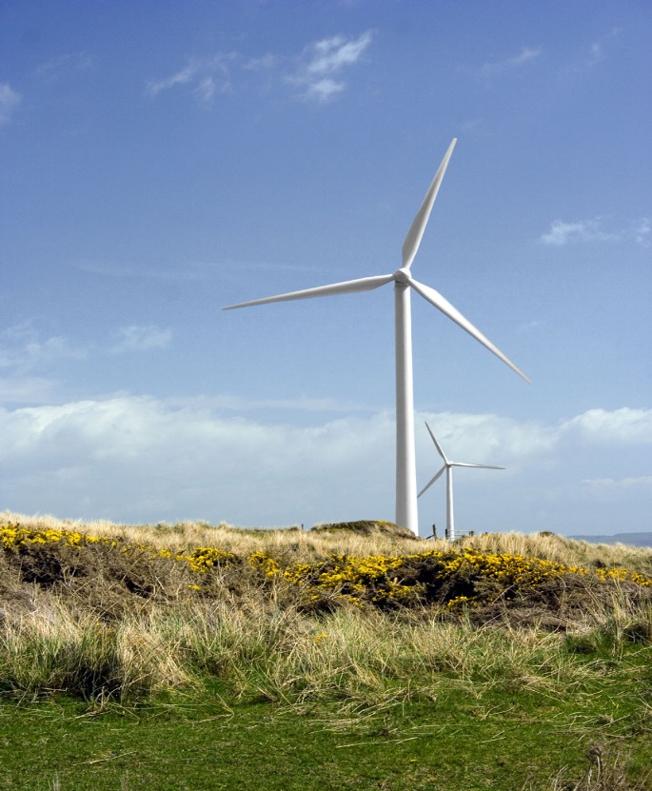
Wind-to-electricity projects overview
The total capacity of wind power put into operation by the end of 2021 is about 3,343 MW, much less than the total wind power capacity approved to be included in the revised PDP 7 -12 GW. Most projects are in the Southwest and South Central regions.

Slide 8
CURRENT GOVERNMENT’S POLICIES ON SOLAR ENERGY

Slide 9
Solar energy projects overview
By the end of 2021, the total solar power capacity (including floating) put into operation was about 27 GW, concentrated in the southern provinces and the Central Highlands.
Transmission grids are not enough in quantity, especially in Ninh Thuan and Binh Thuan provinces, to accommodate the increasing number of solar power projects and reduction in construction time of them due to advanced technology. As a result, most projects that have come into operation in such localities are being subjected to daily decrease in generating capacity to avoid overloading the regional grid.
Binh Thuan and Ninh Thuan are top 2 provinces where projects are being applied for inclusion in the power master plan. This is due to the provinces’ geographical advantage of having the most sunlight rate during the year in Vietnam

Slide 10
WIND & SOLAR- DIRECT POWER PURCHASE MECHANISM
Mandatory Eligibility Criteria:
Tariffed Customers: existing industrial customers taking service at 22kV or higher
Project Size: larger than 30 MW
Technology Type: wind or solar PV
Renewable Energy Generating Company: owns power plants that are either (i) ready to COD but are not eligible for FiT mechanism or (ii) under construction, included in Power Development Plan and identified investor and will achieve COD within 270 working days
Commercial Agreements: project parties directly negotiate and sign a contract for differences (CfD) which dictates a strike price, an amount of power, and duration of the agreement

Slide 11
WIND & SOLAR- DIRECT POWER PURCHASE MECHANISM
Participants Selection Criteria:
Satisfy mandatory eligibility criteria,
Has no generation capacity limitation due to grid overload as of the registered COD,
Has no PPA with EVN, which is still valid at the time of registration for participation, and
Has a binding in-principle agreement with consumer.
Within 60 working days from the effective of the Decision (estimated in 2023), interested parties can apply to join the DPPA pilot program. Duane Morris could assist interested parties to join the program.

Slide 12
WIND & SOLAR- DIRECT POWER PURCHASE MECHANISM
DPPA model under current draft policy provides as follows:
RE power generators shall sell all powers to EVN/PCs via Vietnam Competitive Wholesale Market,
Customer shall buy power from PC/EVN under a normal retail power contract applicable to industrial customers and
RE power generator and customer only sign a Cfd to determine a strike price of power to ensure RE power generator always receives a "strike price" regardless retail power price under the retail contract and/ or sport market price under Vietnam Competitive Wholesale Market.
DPPA model under current draft policy avoids power retail license for RE power generators
This model does not relate/ support the corporate PPA model where RE power generator sells power directly to customers.

Slide 13
WIND & SOLAR- DIRECT POWER PURCHASE MECHANISM
The enforcement of DPPA is heavily dependent on when the PDP 8 will be approved, as only projects listed in the PDP could participate in the DPPA pilot program.
For solar: The latest draft PDP 8 shows that no new solar power projects will be connected to the national grid until 2031. The latest draft encourages development of solar power projects for self-consumption only.
For solar, it is better to make use of the auction mechanism (will be discussed shortly)
For wind: interested investors should keep an eye on whether your projects are included in the latest draft PDP 8

Slide 14
DRAFT PDP 8
List of potential offshore wind power projects to be considered for investment
No. | Project | Total Capacity (MW) | Location
I | Central, South Central and Southeast regions | 44 612
1 | Offshore of Con Co Island | 1000 | Quang Tri
2 | Offshore of Nhon Ly province | 1000 | Binh Dinh
3 | Offshore of My Cat | 1000 | Binh Dinh
4 | Offshore on PNE sea | 2000 | Binh Dinh
5 | Binh Dinh 3 offshore | 2000 | Binh Dinh
6 | Phu Yen 2 offshore | 4500 | Binh Dinh
7 | An Thuan offshore | 250 | Phu Yen
8 | Phuoc Dinh offshore | 502 | Ninh Thuan
9 | Ninh Thuan Zone 2 Seaside | 1600 | Ninh Thuan
10 | Vinh hai offshore | 500 | Ninh Thuan
11 | Offshore on Ninh Thuan beach | 1800 | Ninh Thuan
12 | Ninh Thuan floating offshore | 2000 | Ninh Thuan
13 | La Gan offshore | 3500 | Binh Thuan
14 | Thang Long offshore | 3400 | Binh Thuan
15 | Maqueri offshore | 3000 | Binh Thuan
16 | Ke Ga (Ham Thuan Nam) offshore | 900 | Binh Thuan
17 | Co Thach offshore | 2000 | Binh Thuan
18 | Binh Thuan offshore | 5000 | Binh Thuan
19 | Vinh Phong offshore | 1000 | Binh Thuan
20 | AMI AC offshore | 1800 | Binh Thuan
21 | Tuy Phong offshore | 4600 | Binh Thuan
22 | Xuyen Moc offshore | 760 | Ba Ria, Vung Tau
23 | FECON Vung Tau offshore | 500 | Ba Ria, Vung Tau

Slide 15
DRAFT PDP 8
No. | Project | Total Capacity (MW) | Location
II | SouthWestern region | 15108
1 | Tra Vinh offshore | 1000 | Tra Vinh
2 | V4 Tra Vinh offshore | 2000 | Tra Vinh
3 | Gulf Tra Vinh offshore | 1000 | Tra Vinh
4 | Ree offshore | 1000 | Tra Vinh
5 | Soc Trang offshore | 2000 | Soc Trang
6 | Ben Tre Main Stream AIT offshore | 500 | Ben Tre
7 | Gulf Ben Tre 3 offshore | 2300 | Ben Tre
8 | Ba Tri Ben Tre offshore | 800 | Ben Tre
9 | Dong Hai 5 offshore | 350 | Bac Lieu
10 | Dong Hai 1 – GD 3 offshore | 550 | Bac Lieu
11 | USA Bac Lieu offshore | 608 | Ca Mau
12 | Ngoc Hien offshore | 3000 | Ca Mau

Slide 16
Latest update on PDP 8
On 11 August 2022, in the conference between Government and enterprises, the Minister of the MOIT Nguyen Hong Dien urged the Prime Minister (PM) to approve the PDP 8 draft promptly. In addition, Mr. Dien also proposed to terminate all FIT regulations for solar/wind power projects pursuant to Decision 13, Decision 37 and Decision 39 so that EVN could negotiate the market power price of all transitional renewable power projects.
PM Pham Minh Chinh instructed that renewable power projects are encouraged to be implemented but the price must be appropriately adjusted. PM Chinh argued that the FIT for renewable power projects is approx. 2 times higher than the purchase price for other sources.
On 18 August 2022, another draft PDP8 under OL 4697-TTr-BCT from the MOIT was submitted to the Government.
On 20 August 2022, the Government has arranged an important meeting chaired by the Prime Minister Pham Minh Chinh and joined by several cabinet members such as Ministers of Ministry of Planning and Investment, Ministry of Industry and Trade, Ministry of Justice, Ministry of Finance, Ministry of Agriculture and Rural Development, Ministry of Construction, Ministry of Natural Resources and Environment to discuss the pending points of draft PDP8. MOIT would consider revising its draft again to satisfy the Government, Prime Minister.
So far, it is not clear when PDP8 has not yet adopted/finalized. Hopefully, it could be adopted September 2022 but could be within this year.

Slide 17
What we hear from investors re. PDP 8
regulatory space is non-existent/immature
PDP 8 is languishing
PPAs are not bankable
BD expenditures are too rich
Regulatory space is non-existent/ immature
Project development cycle times are off the charts

Slide 18
Investors must bid to develop solar power projects soon
No FiT rate applicable for project with COD from 1 January 2021 onwards.
In 2021, the Ministry of Industry and Trade issued the draft Decision of the Prime Minister guiding the selection of investors implementing solar power projects under the bidding mechanism (“the Draft”)
According to the Draft, the Decision would be applicable to projects with grids connected directly to the national power network. Every 02 years, the Ministry of Industry and Trade shall issue a Price Framework for electricity generation in order to determine the ceiling price for bidding to select investors of solar power projects with COD in the next 02 years.
The employment of bidding method will enable for the selection of capable developers through transparent procedures in order to eliminate projects that run behind schedule for years

Slide 19
Draft Decision on auction mechanism
1. Applicable solar power purchase price: is the price for the connection point proposed by the winning bidder/investor in the bidding dossier (excluding value added tax)
2. Adjustment to investment schedule: if the investor is permitted to adjust the investment schedule and the project’s COD occurs after the commitment date stated in the bidding documents, the applicable electricity price of project is the electricity selling price specified in point (1) with a cumulative reduction rate of 4% for every 90 days of schedule delay. Project delay time must not exceed 12 months
3. Bidding procedure: People's Committees of localities to publish the bidding dossiers. The investor submits a Bid which includes Technical Proposal and Power Price Proposal. Bid opening will be conducted twice, Technical Proposal will be opened right after the deadline for submission of bids, investors who satisfy technical requirements will have their Power Price Proposals examined for evaluation.
4. Bidding guarantee: Investors must apply the bid security measure, which is equal to 0.5% of the total project invesment, before the bid is closed.

Slide 20
Rooftop Solar Power Projects
Electricity Buyer can either be:
(i) Electricity Vietnam (EVN) or an authorized representative of EVN; or
(ii) In case the RTS system is not connected to EVN’s power grids: organizations, individuals purchasing electricity from the Seller/RTS developer or an authorized representative of such organizations and individuals.
In case the Buyer is EVN, the Seller and Buyer must sign the standard Power Purchase Agreement (“PPA”) unless agreed otherwise. The PPA is valid for 20 years from Commercial Operation Date (“COD”). Seller and other independent Buyers can discuss and agree on the order of implementation, installation, connection and maintenance as well as electricity purchase price by themselves in accordance with Vietnam laws.

Slide 21
Rooftop Solar Power Projects
Proposed FiT rate for RTS projects with COD in 2021 and EVN as Buyer:
FiT rate for RTS projects with COD in 2022 and beyond shall be submitted by the Ministry of Industry and Trade for Prime Minister’s approval.
No. | Capacity of the RTS system | Electricity Purchase Price
 |  | VND/kWh | Equivalent USCent/kWh
1 | < 20 kWp | 1.582,16 | 6,84
2 | From 20 kWp to less than 100 kWp | 1.468,82 | 6,35
3 | From 100 kWp to 1,250 kWp (less than 01 Mwac) | 1.362,41 | 5,89

Slide 22
Don’t forget the EU – Vietnam FTA and CPTPP
EU – Vietnam FTA (“EVFTA”) and the Investment Protection Agreement (“IPA”):
EVFTA came into effect on 1 August 2020, making Vietnam has more legal certainty than even Germany.
IPA implements investor-to-state dispute settlement (ISDS) mechanisms – investors can claim in case that an investor protection obligation has been breached
Domestic courts cannot question the legal validity of the decisions
Comprehensive and Progressive Agreement for the Trans-Pacific Partnership (CPTPP):
TPP continues without the US, effective from 30 December 2018.
New TPP accounts for 12.9% of global GDP and 14.9% of global trade.

Slide 23
Key department of EVN – Ban Thị Trường
Officials from Ban Thi Truong (Market Department) are responsible for negotiating Power Purchase Agreements.
Responsible persons:
- Mr. Tran Dang Khoa: Head of Market Department
- Ms. Minh Loan, Mr. Minh Tuan, Mr. Trung: Deputy Heads of Market Department

Slide 24
Non-recourse financing
What is it? The Project can be financed with a loan secured by a charge on specific assets or on the revenues generated from a specific project or assets.
How to obtain?
Option 1: To develop the project by way of entering into a BOT (Build-Operate-Transfer) contract with the Government. As it is the Government who will own the project at the end upon the expiration of the BOT contract, the BOT contract will be more bankable → the non-recourse/limited recourse financing arrangement can be achievable.
Option 2: To seek guarantee from the Multilateral Investment Guarantee Agency (“MIGA”).
Option 3: To cooperate with a State-owned commercial bank for its guarantee of the project and then, negotiate with lenders to eliminate all recourses that lenders may ask from the sponsors and/or the borrowers.

Slide 25
Investment guideline for foreign investors

Slide 26
Market access and Forms of investment
No foreign ownership restriction
Investment forms:
A wholly-owned foreign enterprise
A joint venture company between a foreign investor and domestic investor
Investment pursuant to the BOT legal framework
Through the purchase of shares in either an EVN subsidiary being or having been equitized or a private IPP holding power assets.

Slide 27
WTO ANALYSIS OF LIBERALIZATION OF MARKET ACCESS
Country | Limitation of market access* | Country | Limitation of market access*
Malaysia | medium | Myanmar | high
Indonesia | medium | Cambodia | medium
Philippines | medium | Laos | medium
Singapore | low | India | high
Thailand | medium | China | medium
Brunei | high | Vietnam | low
* Typical restrictions: number of opened sectors, JV requirement, limits on foreign-owned shares, permission requirement
Copyright Oliver Massmann - All rights reserved

Slide 28
Financing options for power projects
Government investment funding and preferential policies
Official Development Assistance (ODA)
Loan from commercial banks or financial institutions
Clean Development Mechanism (CDM)
Public Private Partnership (PPP)

Slide 29
BOT – BEST INVESTMENT FORM
New Law on Investment in the form of Public-Private Partnership came into effect on 1 January 2021: making projects more bankable
Easier to negotiate more favorable electricity rates.
Easier to obtain more government guarantees, especially in terms of EVN’s obligations to purchase all electricity from the project.
More fiscal and financial incentives.
Precedent large-scaled BOT power projects in Vietnam: Phu My, Vung Ang, Mong Duong 2, Dung Quat 2, Song Hau 2, and many others

Slide 30
Project licensing
Step 1: The investor obtains approval from the competent authority [e.g., Prime Minister, MOIT] approving the power plant as part of the power development plan (if required).
Step 2: The investor obtains in-principle approval from the competent People’s Committee
Step 3: Application for issuance of the Investment Registration Certificate and the Enterprise Registration Certificate
Step 4: Preparation of construction / operations of the power plant (for example, acquiring land area, site clearance, preparation, land investigation, conducting environmental assessment)
Step 5: The project company to obtain necessary permits (e.g. electricity generating permit) and relevant agreements (e.g. PPA) for its and the power plant’s operation.
Step 6: Construction of the power plant and operation

Slide 31
RECOMMENDATIONS FOR INVESTORS
Public private partnerships (e.g. - BOT) should be the first option.
Due care on negotiations of the PPA and grid connection agreement with EVN
Electricity selling in off-grid areas can be a good choice
Sound financing structure, good business model and great legal assistance are keys to success.
Accurate prediction of where the market is heading to, in the context of Vietnam’s critical power shortage, should be considered.
More pressure on the government to adequately address key issues on tariff increase, demonopolization of the power market and government guarantee.
Vietnam’s market is extremely in need of financing and EPC capability. There are rooms for cost-effective and high quality EPC contractors and resourceful lenders.
In many cases, you can “test the water” with a small power plant project.

Slide 32
CONNECTIONS ARE BUSINESS PLEASE CONNECT WITH ME ON LINKEDIN: OLIVER MASSMANN

Slide 33
WHEREVER YOU ARE - BE ALL THERE Jim Elliot

Slide 34
DUANE MORRIS VIETNAM LLC
Thank you very much!
HANOI OFFICE HO CHI MINH CITY OFFICE
Pacific Place, Unit V1307/08, 13th Floor, Suite 1503/04, Saigon Tower
83B Ly Thuong Kiet, Hoan Kiem District 29 Le Duan Street, District 1
Hanoi, Vietnam Ho Chi Minh City, Vietnam
Tel.: +84 24 3946 2200 Tel.: +84 28 3824 0240
Fax: +84 24 3946 1311 Fax: +84 28 3824 0241
Contact email:
omassmann@duanemorris.com

