Slide 1

Future Energy of Vietnam:
Opportunities and Challenges
DR. OLIVER MASSMANN - PARTNER, GENERAL DIRECTOR
DUANE MORRIS VIETNAM LLC
©2023 Duane Morris LLP. All Rights Reserved. Duane Morris is a registered service mark of Duane Morris LLP.
Duane Morris – Firm and Affiliate Offices | New York | London | Singapore | Los Angeles | Chicago | Houston | Hanoi | Philadelphia | San Diego | San Francisco | Baltimore | Boston | Washington, D.C.
Las Vegas | Atlanta | Miami | Pittsburgh | Newark | Boca Raton | Wilmington | Cherry Hill | Princeton | Lake Tahoe | Ho Chi Minh City | Duane Morris LLP – A Delaware limited liability partnership
1
www.duanemorris.com

Slide 2

Vietnam Economy at a glance
• Nominal GDP: US$449.09 billion
• GDP per capita: US$3,756 (2021)
• GDP Growth: 5.8%
• Inflation: 4.89% (as of Jan 2023)
• Population: About 99.3 million
• Total export and import turnover : US$
730.2 billion in 2022 (increase by 9.1%
compared with 2021)
• Regional Minimum wage (Region I): VND
4,680,000 (US$ 198.8) per month (June
2022)
• Vietnam’s average age: 30.9 years old
• Recently, the Power Development Plan VIII
(PDP 8) was approved by the Government
and it is expected that investment into
renewable energy sector will boom in the
coming time
2
www.duanemorris.com

Slide 3

Power Development Plan 8
• The Power Development Plan 8 was approved
on 15 May 2023 under Decision No. 500/QD-
TTg.
• PDP8 sets out the goal of ensuring national
energy security for Vietnam by 2050 to meet the
target of socio-economic development with an
average GDP growth rate of about 7%/year in
the period of 2021-2030; 6.5%-7.5%/year for
the period 2031-2050.
• The goal is to achieve a renewable energy ratio
of 47% according to the commitment on
equitable energy transition with Vietnam (JETP).
With an orientation to 2050, the ratio of
renewable energy is expected to be up to 67.5 -
71.5%.
3
www.duanemorris.com

Slide 4
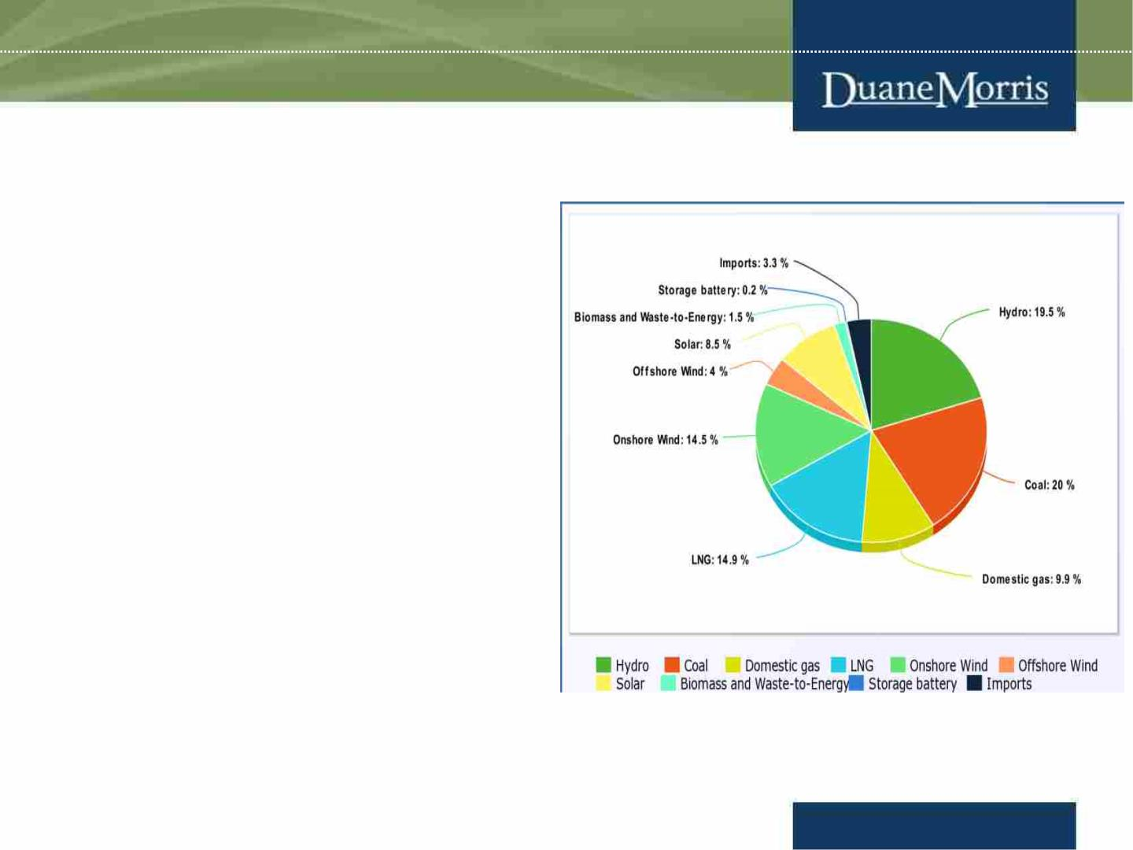
Power Development Plan 8 (cont.)
• According to the PDP8, by 2030, the
planned energy resource for local
consumption shall reach 150,489 MW
consisting of: (i) Hydro energy:
29,346MW; (ii) Coal-fired power:
30,127MW, (iii) Domestic gas:
14,930MW; (iv) LNG: 22,400MW; (v)
onshore wind power: 21,880MW; (vi)
offshore wind power: 6,000MW; (vii)
solar power: 12,836MW; (viii)
biomass and WTE 2,270MW, (ix)
storage battery energy around
300MW and (x) foreign imported
power 5,000MW. Meanwhile, the
capacity for exporting is 5,000 –
10,000 MW.
4
www.duanemorris.com

Slide 5

Power Development Plan 8 (cont.)
• From 2021 to 2030, investment for power generation and transmission systems is
estimated to be $134.7 billion, including $119.8 billion for power generation and
$14.9 billion for transmission systems.
• By 2030, two inter-regional renewable hubs will be set up for electricity generation,
transmission and consumption, and manufacturing and services of renewable energy
equipment
• The smart grid system is encouraged to be developed.
• The transmission grid system is given the green light for investment and
development by private investors at a later stage.
• It is the aim of the PDP8 to have 50% of residential houses and offices to have
rooftop solar system for on-site consumption.
• The pilot program for the Direct Power Purchase Agreement (DPPA) mechanism is
encouraged and urged by the Prime Minister to be implemented.
5
www.duanemorris.com

Slide 6
Power Development Plan 8 (cont.)
• To implement the PDP8, a plan for implementation of PDP8 shall be drafted by
MOIT and submitted to the Prime Minister for approval by June 2023 (Plan for
Implementation).
• On June 17, 2023, the Energy Institute issued the Official Letter No. 0975/VNL-P8
to report to the Ministry of Industry and Trade (the MOIT) about the development
of the implementation plan of the PDP8 in response to the Letter No. 3748/BCT-
DL from the MOIT to the Energy Institute. On this Letter, the Energy Institute
explained the completing the PDP8 planning tasks by June 2023 is impossible.
Therefore, it is recommended that the MOIT allocate a reasonable timeframe for the
Energy Institute to implement the planning tasks. Additionally, it is recommended to
arrange funding to support the Institute in developing the planning tasks and
reviewing the annual plan.
6
www.duanemorris.com

Slide 7
Power Development Plan 8 (cont.)
• The main instruments for bringing the PDP8 into life being the amended Electricity
Law and the Law on Renewable Energy will be prepared by MOIT and it is expected
that the draft for the mentioned laws will be submitted for the National Assembly’s
approval by 2024. Regarding the DPPA mechanism to be in line with PDP8, the
regulations on DPPA will be finalized by MOIT and submitted to the Government
for approval within this year.
• MOIT is also tasked to coordinate and work with local authorities to review and
address issues under existing regulations, agreements to address issues of projects
and report to the Prime Minister for instruction/ legislation if required.
7
www.duanemorris.com

Slide 8
CURRENT ELECTRICITY SITUATION
• Until now, EVN has successfully developed Vietnam’s Competitive Generation
Market (VCGM) and Vietnam’s Wholesale Electricity Market (VWEM).
• Under the VWEM, power plant with a installed capacity of over 30 MW directly
participates in the electricity market while hydropower plants with installed
capacity of 30 MW or less have the right to choose to participate in the electricity
market when they fully satisfy the conditions on infrastructure. The buyers are
EVN and electricity buyers satisfying the relevant conditions.
• The ancillary service providers are the National Load Dispatch Center
(EVNNLDC); National Power Transmission Corporation (EVNNPTC) and
other subsidiaries of EVN.
• Under both the VCGM and the VWEM, EVN and its subsidiaries are currently
enjoying a vertically integrated monopoly.
www.duanemorris.com

Slide 9

CURRENT ELECTRICITY SITUATION
(cont.)
• Insufficient electricity supply due to
drought in the North and malfunctions of
thermal power machineries.
• Offices in Hanoi have experienced short
power outages and there have been
incidents of people trapped in
condominium elevators due to blackouts.
• As reported, one of the industrial park’s
developer in the North of were told to cut
power 50% on blackout risk, leading to
suspension of production of many
factories.
www.duanemorris.com

Slide 10
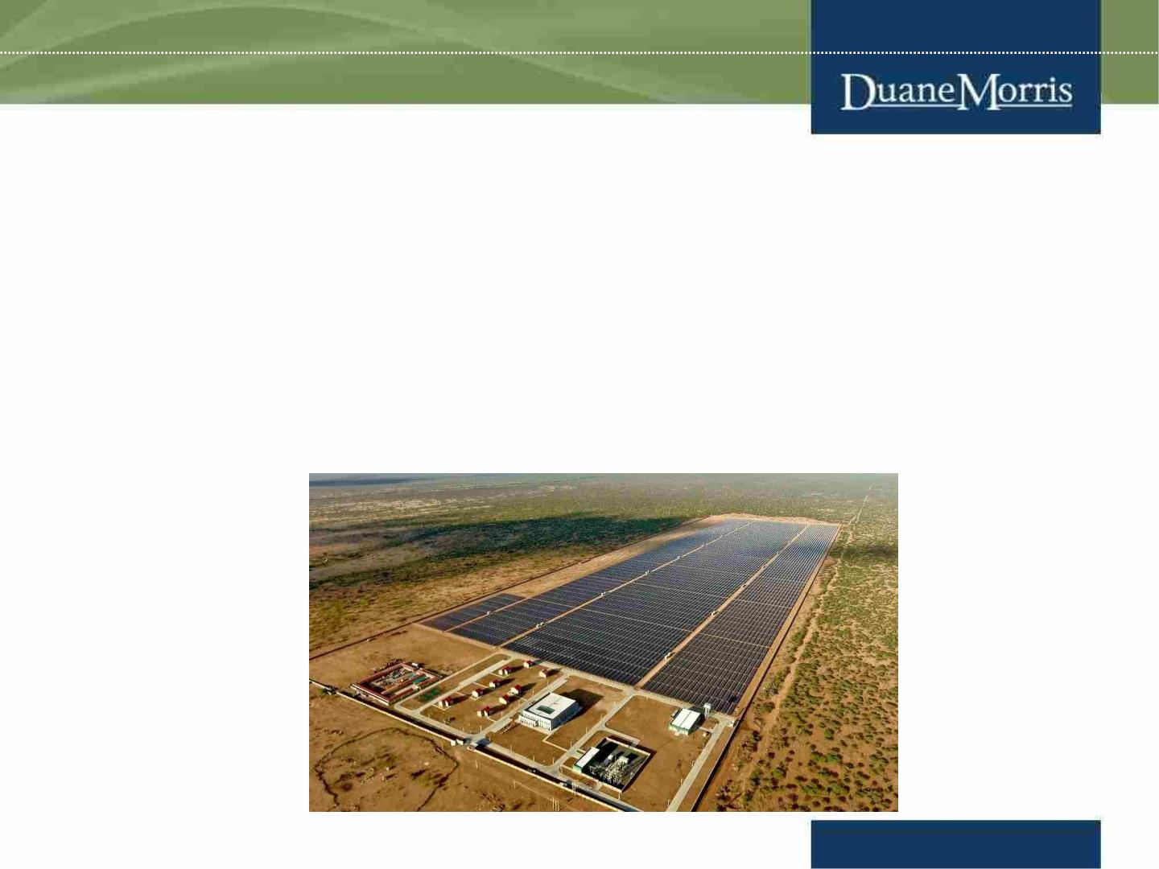
CURRENT ELECTRICITY SITUATION
(cont.)
• The transmission network is under great pressure and is experiencing congestion
since transmission grids are not enough in quantity, especially in Ninh Thuan and
Binh Thuan provinces, to accommodate the increasing number of solar power
projects and reduction in construction time of them due to advanced technology.
As a result, most projects that have come into operation in such localities are
being subjected to daily decrease in generating capacity to avoid overloading the
regional grid.
www.duanemorris.com

Slide 11
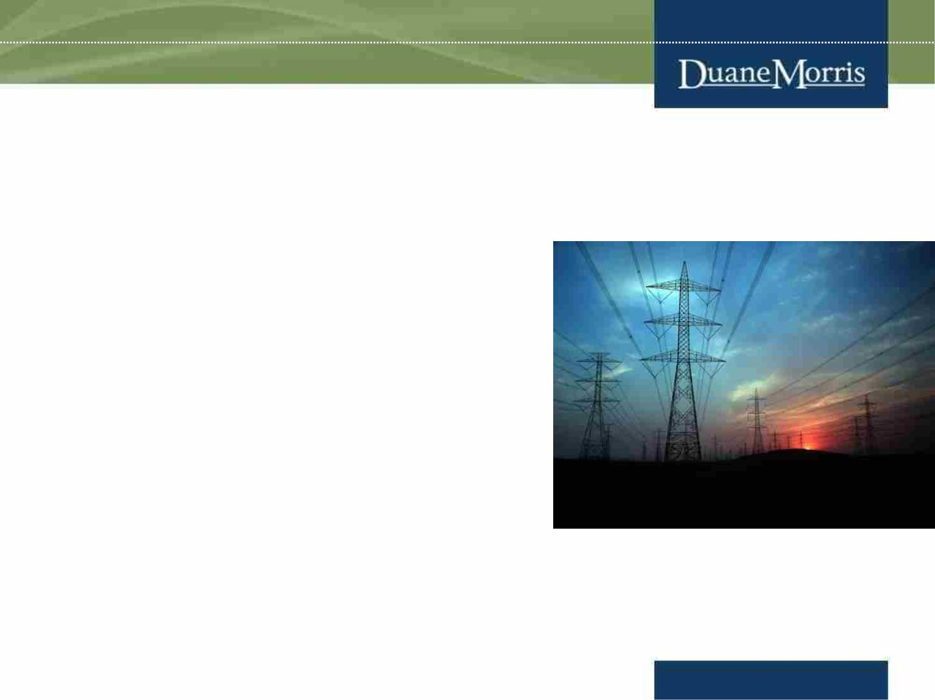
CURRENT ELECTRICITY SITUATION
(cont.)
• 220 renewable power plants have not been
fully dispatched due to local congestion.
• During low-peak hours, over-generation
occurs due to high renewable penetration.
• Lack of incentive mechanism for ancillary
services and currently, there is no mechanism
for operations of smart grid/battery energy
storage system.
• Infightings are in place as the Director of the
National Load Dispatch Centre was
temporarily suspended to serve the
specialized inspection in the management and
administration of power supply.
www.duanemorris.com

Slide 12

Price range of power purchased by EVN in recent
PPAs and distributed to the customers
COMPARISON TABLE FOR AVERAGE ELECTRICITY PRICE FOR
COUNTRIES IN SOUTH EAST ASIA (FOR REFERENCE ONLY)
Vietnam
Thailand
Singapore
Cambodia
Household
Business
0.11
0.13
0.21
0.148
0.13
0.15
0.21
0.148
www.duanemorris.com

Slide 13
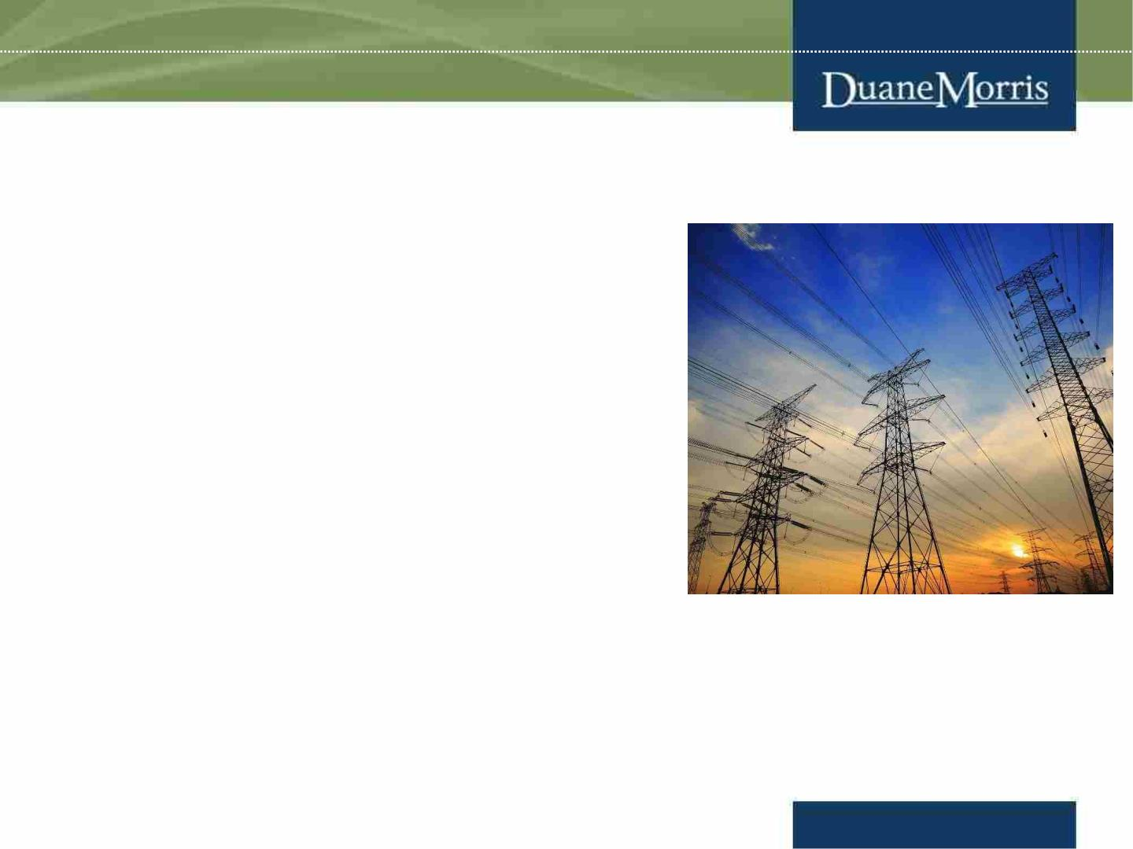
Transmission Grid and Smart Grid
• Electricity of Vietnam (EVN) currently holds a
monopoly
on
electricity
transmission,
distribution, wholesale, and retail.
• Under the PDP 8, in the future, private entities
can take part in the development of electricity.
• Currently, National Power Transmission
Corporation – a subsidiary of EVN – is the only
company to manage and operate the
transmission system.
13
www.duanemorris.com

Slide 14
Transmission Grid and Smart Grid (cont.)
Power Grid development plan under the PDP 8
• Developing both 500 kV and 220 kV transmission power grids to support the
capacity of power sources, improve the reliability of power supply, reduce power
loss
• Fostering collaboration in research and grid connection implementation with
neighboring countries, Southeast Asian nations, and Greater Mekong Sub-region
(GMS) countries.
• Connecting the power grid with Laos with 500kV and 220kV transmission lines to
import electricity from power plants in Laos according to the memorandum of
understanding signed between the two governments.
14
www.duanemorris.com

Slide 15
Solar and Rooftop Solar power projects
• Rooftop solar power systems are encouraged to be developed by the PDP 8.
• On June 13, 2023, the Ministry of Industry and Trade submitted a draft of a
mechanism to encourage the development of rooftop solar power installation in
houses, offices, and corporate headquarters in Vietnam with the following
incentives/requirements:
Ø Total capacity of the rooftop solar power system is prioritized for development
without capacity limit and belongs to the PDP 8;
Ø Organizations and individuals investing in the development of rooftop solar
power systems are exempted from electricity activity licenses and electricity
business registration certificates;
Ø Rooftop solar power systems installed in offices are prioritized for budget
allocation for implementation;
Ø Organizations and individuals investing in and using the Rooftop Solar Power
System are entitled to receive or reduce taxes and fees; loans at preferred interest
rates as prescribed by law.
15
www.duanemorris.com

Slide 16
Solar and Rooftop Solar power projects (cont.)
Ø Rooftop solar power system installed into the electricity grid system that has
been connected in accordance with regulations on the distribution power system
is not required to perform the connection agreement. Previously installed
Rooftop Solar PV Systems that meet regulatory conditions will also be eligible
for this incentive;
Ø Organizations and individuals investing, installing and using the rooftop solar
power system must ensure the requirements on electrical safety, construction
safety, environment, fire prevention and fighting according to current
regulations.
• According to the PDP8, solar power projects that have been planned for the period
of 2021 - 2030 but have not yet been assigned to investors are not allowed to be
implemented and will be put on hold after 2030 with the exception of on-site
consumption without connecting to the grid, provided that there are no violations of
planning, land and other provisions of the law
16
www.duanemorris.com

Slide 17
Direct Power Purchase Agreement (DPPA)
• Major international companies, including Samsung, Adidas, LG, etc. wish to take part
in the pilot program of the DPPA.
• As believed, the DPPA is an important mechanism to attract investors and private
investments, not only in the energy sector but also in other sectors where companies
have made commitments in the space of renewable energy, carbon reduction, and
sustainability, e.g. trading of carbon credits.
• In 2022, a draft decision of the Prime Minister on a pilot program for the DPPA
mechanism was published. Such a program offers a look into the possible structure
of the DPPA mechanism under PDP 8.
17
www.duanemorris.com

Slide 18
Direct Power Purchase Agreement (DPPA)
(cont.)
Under the draft pilot program, the DPPA mechanism works as follows:
1. the renewable energy generator will enter into a DPPA in the form of a forward
contract with a customer, under which the customer will guarantee a fixed price for
the energy produced by the renewable energy project and in return, the generator will
transfer the “environmental attributes” created by the project to the customer;
2. the generator will sell all of the generated electric energy to EVN in the wholesale
electricity market under a template power purchase agreement provided in the Draft
Decision. The power companies of EVN will then sell electric energy to the
customer at retail prices. Such electric energy may not necessarily come from the
project; and
3. if the price that the generator sells its energy in the wholesale electricity market
(Floating Price) is lower than the fixed price, the customer will pay the generator the
shortfall. If the Floating Price is higher than the fixed price, the generator will pay the
generator the excess.
18
www.duanemorris.com

Slide 19
Transitional projects under the PDP 8
• Transitional wind and solar power projects are projects for which PPAs were executed
with EVN before 1 January 2021 in respect of solar power projects and 1 November 2021
in respect of wind power projects, but which did not achieve COD (1 November 2021 for
wind power and between 1 July 2019 and 31 December 2020 for solar power) within the
deadline to be eligible for the favourable feed-in tariffs under Decision No. 13/2020/QD-
TTg regarding solar power and Decision No. 39/2018/QD-TTg regarding wind power.
These projects have faced considerable difficulty in achieving COD or obtaining financing
due to the lack of certainty regarding the applicable tariff rate.
www.duanemorris.com

Slide 20

Transitional projects under the PDP 8 (cont.)
On 26 April 2023, 26 April: EVN provides further guidance on price negotiation
process for investors of transitional power projects whereby projects of which the price
negotiation dossiers have been submitted to EPTC, the tariff after review is > 50% of
the ceiling price in Decision 21/QD-BCT, and the investors proposed a temporary
tariff <= 50% of the ceiling price while waiting for the negotiation result: EPTC
urgently negotiates and aligns a temporary tariff with investors without retroactive
payment until the final tariff is agreed.
•
No.
Type
Ceiling price
(VND/kWh)
1
2
3
4
Ground-mounted solar power plant
Floating solar power plant
1,184.90
1,508.27
1,587.12
1,815.95
Onshore wind power plant
Offshore wind power plant
www.duanemorris.com

Slide 21
Transitional projects under the PDP 8 (cont.)
• Recently, 31/85 investors have submitted price negotiation dossiers to EVN
• On 10 May, 10 May: EVN agreed the temporary tariffs with 2 investors (Nam Binh 1 wind
project, Vien An wind project). The agreed tariffs have not been published.
• On 17 May, according to the meeting between the MOIT and the Deputy Prime Minister
– Mr. Tran Hong Ha – the MOIT was asked to (i) urgently revise relevant documents on
tariffs for transitional power projects. In the meantime, provide guidance on price
negotiation process (e.g. tariff calculation methods). Study other methods for calculation
of tariffs that could offer an acceptable level of profits and make economic sense for
businesses; (ii) Accelerate electricity operations licensing process for already completed
projects.
www.duanemorris.com

Slide 22

Investment into the power sector
• Under WTO Commitments, EVFTA and CPTPP, Vietnam has not committed
on the production, transmission and distribution of electricity.
• Under the EVFTA, Vietnam retains the right to adopt or maintain measure to
the operations of enterprises implementing the transmission and distribution of
electricity.
• Under the CPTPP, Vietnam reserves the right to adopt or maintain any measure
with respect to hydroelectricity and nuclear power.
• As for production of electricity, it is common practice that foreign investors can
implement such business with no foreign ownership restriction.
• Until now, Trung Nam Group – a domestic group - is the only entity known to
be allowed to develop 500kV substation and 500kV, 220kV transmission line as
a pilot program.
22
www.duanemorris.com

Slide 23
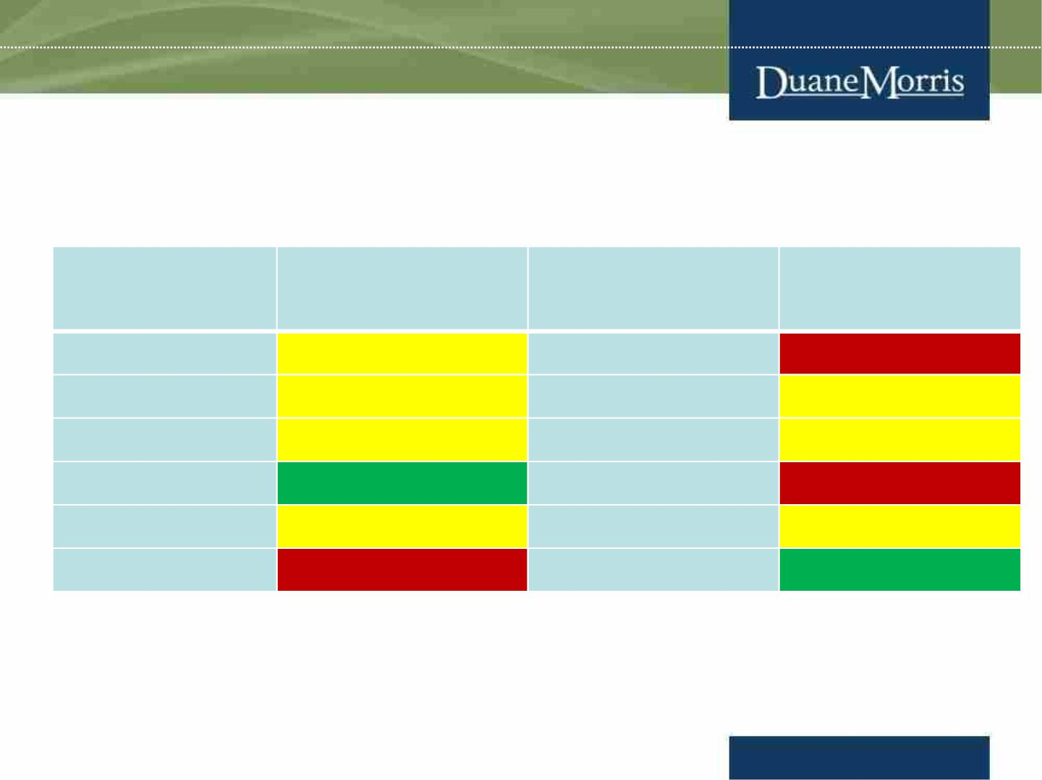
Investment into the power sector (cont.)
WTO analysis of liberalization of market access
Country
Limitation of market
access*
Country
Limitation of
market access*
Malaysia
Indonesia
Philippines
Singapore
Thailand
Brunei
medium
medium
medium
low
Myanmar
Cambodia
Laos
high
medium
medium
high
India
medium
high
China
medium
low
Vietnam
* Typical restrictions: number of opened sectors, JV requirement, limits on foreign-
owned shares, permission requirement
Copyright Oliver Massmann - All rights reserved
23
www.duanemorris.com

Slide 24
Investment into the power sector (cont.)
• The infrastructure of the electricity grid creates a natural monopoly – very similar
to telecommunication infrastructure, railroads, or motorways.
• Public private partnerships (e.g. - BOT) should be the first option.
• Due care on negotiations of the PPA and grid connection agreement with EVN
• Electricity selling in off-grid areas can be a good choice
• Sound financing structure, good business model and great legal assistance are keys
to success.
• Accurate prediction of where the market is heading to, in the context of Vietnam’s
critical power shortage, should be considered.
24
www.duanemorris.com

Slide 25
Investment into the power sector (cont.)
• More pressure on the government to adequately address key issues on tariff
increase, demonopolization of the power market and government guarantee.
• Vietnam’s market is extremely in need of financing and EPC capability. There are
rooms for cost-effective and high quality EPC contractors and resourceful lenders.
• In many cases, you can “test the water” with a small power plant project.
25
www.duanemorris.com

Slide 26
Key department EVN – Electricity Market
Department
• Officials from Ban Thi Truong Dien (Electricity Market
Department) are responsible for negotiating Power
Purchase Agreements.
• Responsible persons (Last updated on August 2022):
- Mr. Tran Dang Khoa: Head of Market Department
- Ms. Minh Loan, Mr. Minh Tuan, Mr. Trung: Deputy Heads of
Market Department
www.duanemorris.com

Slide 27
Case study: the EU and Germany
• Thirty years ago, the European electricity sector was a monopoly. Vertically
integrated companies were responsible for generation, transmission and supply
of electricity.
• In 1996 the European Union started to gradually open the market for
competition – to liberalize the energy market just like it did before with several
other sectors.
• A key step in this process was and is the unbundling of the European power
sector with the aim to split up the generation, transmission, distribution and
retail activities. As a result of the unbundling process, the vertically integrated
companies can no longer both generate, transport, trade and supply electricity
while managing the transmission and distribution networks.
27
www.duanemorris.com

Slide 28
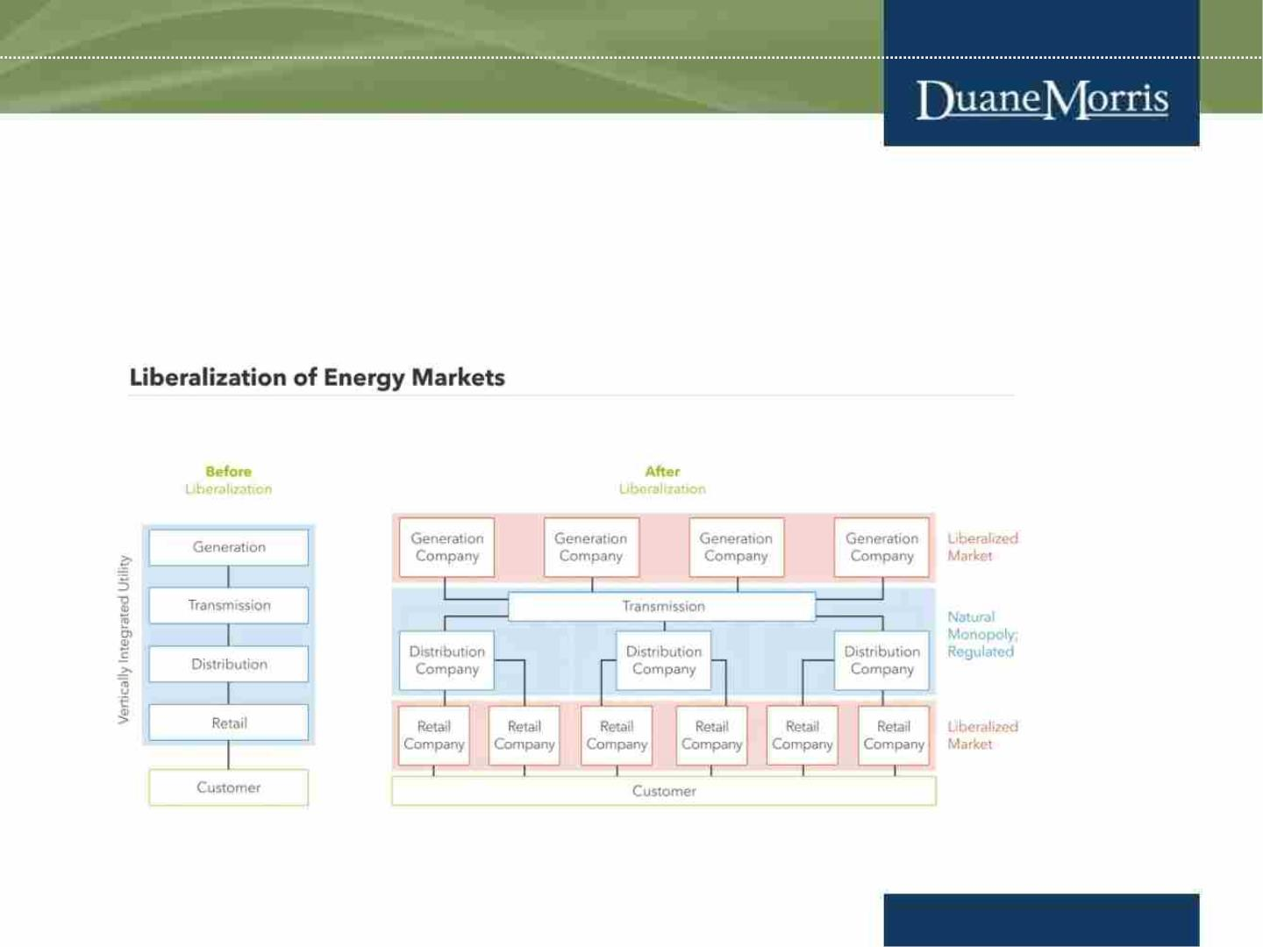
Case study: the EU and Germany (cont.)
• The process of unbundling was to achieve the fully-integrated, further
decarbonized electricity market and ensures security of supply through solidarity
and cooperation between EU member states.
28
www.duanemorris.com

Slide 29
Case study: the EU and Germany (cont.)
• Thanks to the market premium model, renewable energy systems can even offer
their electricity at negative prices, which gives them high priority in dispatch.
Negative electricity prices provide incentives for controllable producers to make
generation more flexible, as inflexible assets exacerbate the magnitude of
negative prices. Consumers can also play their part, bidding flexibility by shifting
demand to low-price periods.
• Both on the supply and demand side, liberalization has established competitive
forces that promote a more cost-effective power system. Consumers are free to
choose their electricity supplier and thus create competition between energy
providers.
• For household customers, liberalisation has led to a lasting reduction in the costs
associated with generating and transporting electricity. While the final price paid
by household customers is now approximately twice as high as it was before
liberalisation, this is attributable to higher taxes and levies, particularly for
subsidising the expansion of renewables.
29
www.duanemorris.com

Slide 30
Energy Solutions
• Development of the DPPA mechanism to allow consumers to buy electricity
directly from renewable power plants.
• Development of mechanism to facilitate the participation in ancillary services to
support the national grid.
• Development of pilot program for the mechanisms for BESS and smart grid for
private investors.
• Allowing investors to contribute to the development of the the grid system.
• Approval and issuance of relevant regulations on renewable energy (Law on
Renewable Energy, DPPA pilot program, etc.)
• Development of new financial mechanisms for investors to hedge the risk of
price different between load’s node and the generator’s node; to create new
forms of financial contracts for financing purpose; to create new derivative
financial market, etc.
30
www.duanemorris.com

Slide 31
CONNECTIONS ARE BUSINESS
PLEASE CONNECT WITH ME ON
LINKEDIN:
OLIVER MASSMANN
31
www.duanemorris.com

Slide 32
WHEREVER YOU ARE - BE ALL THERE
Jim Elliot
32
www.duanemorris.com

Slide 33
DUANE MORRIS VIETNAM LLC
Thank you very much!
HANOI OFFICE
HO CHI MINH CITY OFFICE
Pacific Place, Unit V1307/08, 13th Floor,
83B Ly Thuong Kiet, Hoan Kiem District
Hanoi, Vietnam
Suite 1503/04, Saigon Tower
29 Le Duan Street, District 1
Ho Chi Minh City, Vietnam
Tel.: +84 28 3824 0240
Tel.: +84 24 3946 2200
Fax: +84 24 3946 1311
Fax: +84 28 3824 0241
Contact email:
omassmann@duanemorris.com
33
www.duanemorris.com

