Slide 1
Investment into the grid and transmission system in Vietnam
DR. OLIVER MASSMANN - PARTNER, GENERAL DIRECTOR
DUANE MORRIS VIETNAM LLC

Slide 2
Power Development Plan 8
The Power Development Plan 8 was approved on 15 May 2023 under Decision No. 500/QD-TTg.
PDP8 sets out the goal of ensuring national energy security for Vietnam by 2050 to meet the target of socio-economic development with an average GDP growth rate of about 7%/year in the period of 2021-2030; 6.5%-7.5%/year for the period 2031-2050.
The goal is to achieve a renewable energy ratio of 47% according to the commitment on equitable energy transition with Vietnam (JETP). With an orientation to 2050, the ratio of renewable energy is expected to be up to 67.5 - 71.5%.

Slide 3
Power Development Plan 8 (cont.)
From 2021 to 2030, investment for power generation and transmission systems is estimated to be $134.7 billion, including $119.8 billion for power generation and $14.9 billion for transmission systems.
By 2030, two inter-regional renewable hubs will be set up for electricity generation, transmission and consumption, and manufacturing and services of renewable energy equipment
The smart grid system is encouraged to be developed.
The transmission grid system is given the green light for investment and development by private investors at a later stage.
It is the aim of the PDP8 to have 50% of residential houses and offices to have rooftop solar system for on-site consumption.
The pilot program for the Direct Power Purchase Agreement (DPPA) mechanism is encouraged and urged by the Prime Minister to be implemented.

Slide 4
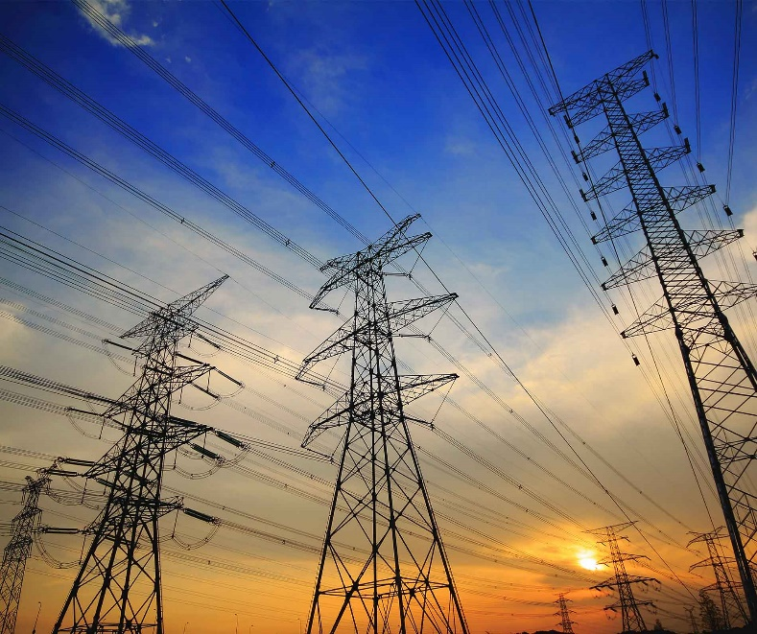
Transmission Grid and Smart Grid
Electricity of Vietnam (EVN) currently holds a monopoly on electricity transmission, distribution, wholesale, and retail.
Under the PDP 8, in the future, private entities can take part in the development of electricity.
Currently, National Power Transmission Corporation – a subsidiary of EVN – is the only company to manage and operate the transmission system.

Slide 5
Transmission Grid and Smart Grid (cont.)
Power Grid development plan under the PDP 8
Developing both 500 kV and 220 kV transmission power grids to support the capacity of power sources, improve the reliability of power supply, reduce power loss
Fostering collaboration in research and grid connection implementation with neighboring countries, Southeast Asian nations, and Greater Mekong Sub-region (GMS) countries.
Connecting the power grid with Laos with 500kV and 220kV transmission lines to import electricity from power plants in Laos according to the memorandum of understanding signed between the two governments.

Slide 6
Investment into the power sector
Under WTO, EVFTA and CPTPP, Vietnam has not committed on the production, transmission and distribution of electricity.
Under the EVFTA, Vietnam retains the right to adopt or maintain measure regarding operations of enterprises implementing the transmission and distribution of electricity.
Under the CPTPP, currently, foreign investment to own or operate power transmission facilities in Viet Nam may not be permitted. EVN is currently the sole authorized owner and operator of power transmission facilities in Vietnam. In the long run, Vietnam reserves the right to adopt or maintain any measure with respect to hydroelectricity and nuclear power.
As for production of electricity, it is a common practice that foreign investors can implement such business with no foreign ownership restriction.
Until now, Trung Nam Group – a domestic group - is the only entity known to be allowed to develop 500kV substation and 500kV, 220kV transmission line as a pilot program.

Slide 7
Investment into the power sector (cont.)
WTO analysis of liberalization of market access
Country | Limitation of market access* | Country | Limitation of market access*
Malaysia | medium | Myanmar | high
Indonesia | medium | Cambodia | medium
Philippines | medium | Laos | medium
Singapore | low | India | high
Thailand | medium | China | medium
Brunei | high | Vietnam | low
* Typical restrictions: number of opened sectors, JV requirement, limits on foreign-owned shares, permission requirement
Copyright Oliver Massmann - All rights reserved

Slide 8
Solution for Investment into the power sector
Public private partnerships (e.g. - BOT) should be the first option.
Due care on negotiations of the PPA and grid connection agreement with EVN.
More pressure on the government to adequately address key issues on tariff increase, demonopolization of the power market and government guarantee.
Close follow-up with the Government on the not-yet-issued laws like the Amended Law on Electricity, Renewable Energy Law, Implementation Plan of the PDP 8, regulations on DPPA, etc.

Slide 9
Solution for Investment into the power sector (cont.)
As Vietnam has not committed on the transmission and distribution of electricity, the Government should allow foreign investment into the grid and transmission system in line with the PDP 8.
It is important that investment into the grid and transmission system must be subject to the assessment procedure by considering the below factors:
National defence;
Potential coercion and geopolitical influence;
Strategic importance of the grid;
Nationality of the investor;
to prevent unwanted investment from competitor(s). It is recommended that big players in the sector should test the water first by showing interests towards investment in the grid and transmission system to the Government, one step at a time!

Slide 10
CONNECTIONS ARE BUSINESS PLEASE CONNECT WITH ME ON LINKEDIN: OLIVER MASSMANN

Slide 11
WHEREVER YOU ARE - BE ALL THERE Jim Elliot

Slide 12
DUANE MORRIS VIETNAM LLC
Thank you very much!
HANOI OFFICE HO CHI MINH CITY OFFICE
Pacific Place, Unit V1307/08, 13th Floor, Suite 1503/04, Saigon Tower
83B Ly Thuong Kiet, Hoan Kiem District 29 Le Duan Street, District 1
Hanoi, Vietnam Ho Chi Minh City, Vietnam
Tel.: +84 24 3946 2200 Tel.: +84 28 3824 0240
Fax: +84 24 3946 1311 Fax: +84 28 3824 0241
Contact email:
omassmann@duanemorris.com

