Slide 1
A Second Trump Presidency: Implications for U.S.-Vietnam Legal and Business Ties – Risks and Openings for Foreign Investors
DUANE MORRIS VIETNAM LLC
©2025 Duane Morris LLP. All Rights Reserved. Duane Morris is a registered service mark of Duane Morris LLP.
Duane Morris - Firm and Affiliate Offices | New York | London | Singapore | Los Angeles | Chicago | Houston | Hanoi | Philadelphia | San Diego | San Francisco | Baltimore | Boston | Washington, D.C.
Las Vegas | Atlanta | Miami | Pittsburgh | Newark | Boca Raton | Wilmington | Cherry Hill | Princeton | Lake Tahoe | Ho Chi Minh City | Duane Morris LLP - A Delaware limited liability partnership
www.duanemorris.com
1
www.duanemorrisselvam.com
www.duanemorrisselvam.com

Slide 2
Vietnam: Some Interesting Facts
=>
Bordering China and strategically located in Southeast Asia, Vietnam serves as a key regional hub.
One of the world’s fastest-growing economies, averaging 7% annual GDP growth since 1990.
A dynamic nation of over 100 million people, with a young, consumption-driven population.
Transitioning from low-cost manufacturing to becoming a high-tech investment destination.
The only Communist country allied with the U.S., offering a unique geopolitical advantage.
A core member of the Sinosphere, sharing deep historical and cultural ties with China, Japan, and Korea.
2
www.duanemorris.com

Slide 3
Vietnam - U.S. Relations: Key Milestones and Future Outlook
1954-1975 | Vietnam War | The fall of Saigon triggered a wave of Vietnamese emigration. In the US, the Vietnamese refugees establish the 'Little Saigon' to honor their lost capital, becoming home to nearly three million Vietnamese residents.
1975 - 1993 | Trade Embargo | The US imposed and lifted a trade embargo on Vietnam
1995 | Normalization | Normalization of diplomatic relations through opening liaison offices in each other’s capitals
2001 | The US – Vietnam BTA | The Bilateral Trade Agreement which paved the way to Vietnam’s accession to the WTO
2023 | Comprehensive Strategic Partnership | Elevation to Comprehensive Strategic Partnership
Onward (New Administration in the US) | Tariffs: Increased tariffs impacting trade dynamics. Deportations: Stricter immigration policies affecting workforce. Efficiency Cuts: Government efficiency measures reshaping bilateral ties | Tariffs: Increased tariffs impacting trade dynamics. Deportations: Stricter immigration policies affecting workforce. Efficiency Cuts: Government efficiency measures reshaping bilateral ties
Onward (Vietnam’s Next Phase) | Vietnam’s move under Mr. To Lam’s "New Era" vision | Vietnam’s move under Mr. To Lam’s "New Era" vision
3
www.duanemorris.com

Slide 4
The New Era - A ‘DOGE’ Version of Vietnam
Economic Reforms
Policy shift: Transition of the Party’s doctrine from ‘peaceful progress’ and ‘anti-corruption’ towards a stronger emphasis on business development.
Economic transformation: Prioritization of the private sector as the primary economic driver, moving away from the dominance of state-owned enterprises (SOEs).
Strategic investment focus: Emphasis on key business infrastructure, renewable energy, and emerging industries such as semiconductors, artificial intelligence (AI), and blockchain technology.
Government Proficiency Improvement
Geographic restructuring: Reduction of provinces from 63 to approximately 30, along with the elimination of district-level administrations.
Administrative consolidation: Merging of ministries and dissolution of many state-related entities nationwide
Bureaucratic streamlining: Significant reduction of regulatory hurdles, particularly in relation to foreign direct investment (FDI).
Personal observation: Mr. To Lam is perceived as U.S.-friendly and highly pragmatic.
4
www.duanemorris.com

Slide 5
US-Vietnam Trade in Figures
5
www.duanemorris.com

Slide 6
US-Vietnam Trade: The Current Landscape
Viet Nam’s export revenue to the U.S. hits about US$119 billion in 2024, up 23.3 percent compared to the previous year
6
www.duanemorris.com

Slide 7
US-Vietnam Trade: The Current Landscape
Globally, Vietnam ranked fourth in terms of trade surplus with the US,
following China, the European Union, and Mexico
7
www.duanemorris.com

Slide 8
US-Vietnam Investment: The Current Landscape
By the end of April 2024, the total registered investment capital of American businesses in Vietnam reached more than 12 billion USD (more than 1,300 projects), ranking 11th in investment value by country.
8
www.duanemorris.com

Slide 9
The New Administration: Impacts, Challenges & Opportunities
9
www.duanemorris.com

Slide 10
The New Administration: Immediate Impacts
Tariffs: The new administration has increased tariffs on steel and aluminum imports, directly affecting Vietnamese exporters. Reciprocal tariffs on all trade partners, including Vietnam, have also been introduced and shall take effect from 09 April 2025.
DOGE Initiative: Musk-led efficiency cuts may reduce US aid, pushing Vietnam toward private investment.
USAID Termination: The termination means cutting of $100 million+ in annual aid, impacting health, education, and disaster relief - key areas for investor confidence.
10
www.duanemorris.com

Slide 11
“Vietnam: great negotiators, great people, they like me. I like them. The problem is they charge us 90%. We’re going to charge them 46% tariff.”
11
www.duanemorris.com

Slide 12
Challenges lie ahead
Vietnam–U.S. Trade Outlook (2024): USD119.6B in exports to the U.S. (29.5% of total) → High market reliance
Increased U.S. tariffs impact key sectors: textiles, footwear, wood, electronics
Reciprocal tariffs under Trump reduce Vietnam’s investment appeal → Shift to lower-tariff countries
Chinese investors do not choose Vietnam for transshipping → impacts on FDI, logistics, IZ developments, etc.
12
www.duanemorris.com

Slide 13
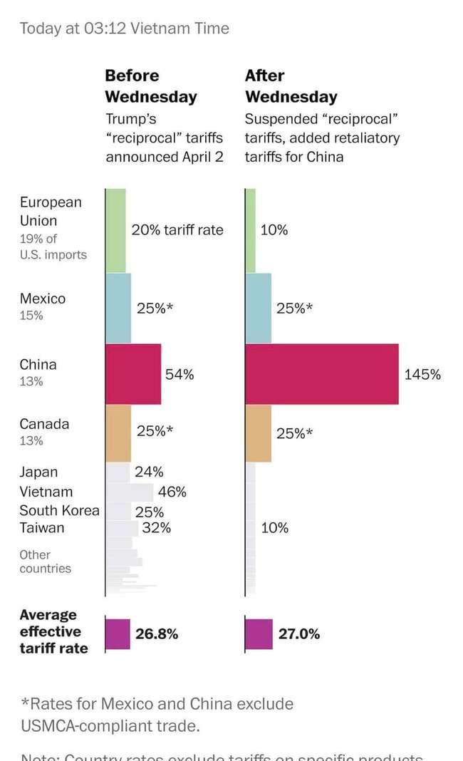
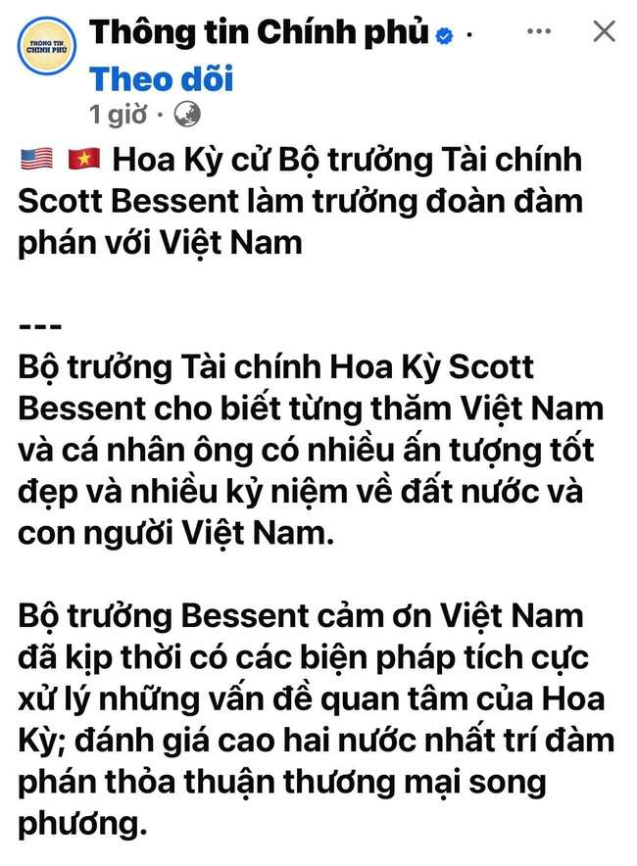
Trump’s tariff policy – Latest updates
12
www.duanemorris.com

Slide 14
What is there for Vietnam?
13
www.duanemorris.com

Slide 15
Hanoi’s bamboo policy
Vietnam has been trying to take diplomatic precautions and sending benevolent messages. Making friends with as many other countries as possible, being flexible and resilient, and above all: growing rapidly.
To appease the US, Vietnam was ready to import more agricultural goods from the US. To reduce the trade deficit, LNG exports to Vietnam were also reportedly discussed. Vietnam's Prime Minister Pham Minh Chinh also paved the way for the nationwide deployment of the Starlink satellite internet system developed by Trump confidant Elon Musk. Multi-billionaire Mukesh Ambani wants to bring Starlink to India at the same time.
Vietnam even did not receive special treatment on its export of steel and aluminum before the new tariffs. However, it is still one of the largest steel suppliers to the USA.
Whether the new 46% tariff on Vietnam’s exports will shift supply chains from Vietnam to neighboring countries remains to be seen. Vietnam’s bamboo diplomacy has failed in Washington for the time being - and it is questionable whether the flourishing trade relations between the two countries will survive the high reciprocal tariffs unscathed.
14
www.duanemorris.com

Slide 16
Been there – done that
1997 Asian Financial Crisis
Impact:
GDP growth fell to 5.76% (1998) and 4.77% (1999).
FDI dropped from 10.2B(1996)to10.2B(1996) to 2.6B (1999).
Inflation surged from 4.5% (1996) to 9.2% (1998).
Recovery (2000–2007):
GDP rebounded to 7.63% annually.
FDI hit $12.9B, and exports grew 5.4x by 2008 (vs. 1999).
Key Drivers: Oil/rice exports + strong government stabilization measures.
15
www.duanemorris.com

Slide 17
Been there – done that
2008 Global Financial Crisis
Impact:
GDP declined from 6.31% (2008) to 5.32% (2009).
FDI plummeted from 71.7B (2008) to 21.5B (2009).
Inflation peaked at 19.89% (2008); trade deficit widened.
Recovery:
Swift policy shifts (monetary/fiscal adjustments).
Public-private cooperation + balanced market-government intervention.
Conclusion
Vietnam has repeatedly overcome external shocks through adaptability, export strength, and unified national efforts—proving its resilience in turbulent times.
16
www.duanemorris.com

Slide 18
Vietnam Competitive Advantages
Cost Edge: Labor costs 50% lower than China, with a skilled workforce growing rapidly.
Trade Network: FTAs with EU, UK, RCEP; strategic US partnership. Vietnam and Singapore are the only two countries to have ever concluded a Free Trade Agreement with the EU – the biggest trading bloc in the world!
Reform Speed: Cut of red tape, reduction of administrative procedures and boost major projects throughout Vietnam.
Political Stability: No regional, religious or ethnic conflicts.
Strategic Ally: Vietnam’s role in countering China’s rise aligns with US interests, bolstered by shared South China Sea concerns.
Women power: Vietnamese women now lead 22 per cent of all enterprises in Vietnam, a level comparable to that in developed countries, such as Sweden (20 per cent), Singapore (24 per cent), and France (24 per cent)
Flexible Bamboo Policy: Diplomatic adaptability - resilient yet pragmatic - ensures stability amid geopolitical shifts, outpacing other ASEAN countries
17
www.duanemorris.com

Slide 19
How should Vietnam deal with Trump?
Keep negotiating with the US for lower tariff
Take advantage of the EVFTA
Actively lobby the remaining 10 EU countries to ratify the EVIPA to best protect interest of EU investors
18
www.duanemorris.com

Slide 20
Divert Vietnam’s export market to the EU
340 million people
Main Vietnam’s exports are:
Computers, electronic products and components
Machinery, equipment, tools and other spare parts
Textiles
Mobile phones and accessories
Wood and wooden products
448 million people
Main Vietnam’s exports are:
Electrical machinery and equipment
Footwear
Mechanical equipment
Garment and accessories
Iron and steel
Coffee
Tea
Spices
www.duanemorris.com

Slide 21
Political talks and negotiation continue…
Zero tariff, more US goods purchase, etc. → talks open
20
www.duanemorris.com

Slide 22
DUANE MORRIS VIETNAM LLC
Thank you very much!
HANOI OFFICE HO CHI MINH CITY OFFICE
Pacific Place, Unit V1307/08, 13ᵗʰ Floor, Suite 1503/04, Saigon Tower
83B Ly Thuong Kiet, Hoan Kiem District 29 Le Duan Street, District 1
Hanoi, Vietnam Ho Chi Minh City, Vietnam
Tel.: +84 24 3946 2200 Tel.: +84 28 3824 0240
Fax: +84 24 3946 1311 Fax: +84 28 3824 0241
21

