Slide 1
Investing and doing business in Vietnam
DR. OLIVER MASSMANN - PARTNER, GENERAL DIRECTOR
DUANE MORRIS VIETNAM LLC

Slide 2
AGENDA
OVERVIEW OF VIETNAM BUSINESS LANDSCAPE
DOING BUSINESS AND INVESTING IN VIETNAM
HOW TO CHOOSE YOUR LOCAL ADVISOR

Slide 3
Overview of Vietnam business landscape

Slide 4
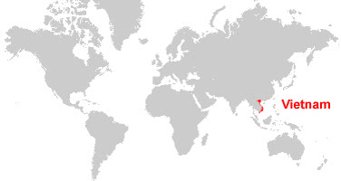
Vietnam: Some Interesting Facts
=>
Bordering China and strategically located in Southeast Asia, Vietnam serves as a key regional hub.
One of the world’s fastest-growing economies, averaging 7% annual GDP growth since 1990.
A dynamic nation of over 100 million people, with a young, consumption-driven population.
Transitioning from low-cost manufacturing to becoming a high-tech investment destination.
The only Communist country allied with the U.S., offering a unique geopolitical advantage.
A core member of the Sinosphere, sharing deep historical and cultural ties with China, Japan, and Korea.
2
www.duanemorris.com

Slide 5
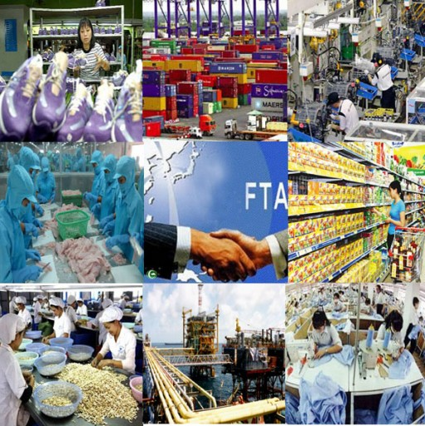
Vietnam Economy at a glance
2024 GDP: US$476.3 billion
GDP per capita: US$4,700
GDP Growth in 2024 increased by 7%
Inflation: 3.63%
Population: About 101 million
Labor force aged 15 and above: 68.9%
Regional Minimum wage (Region I): VND 4,960,000 (US$ 198) per month (effective from 1st July 2024)
Vietnam’s median age: 32.8 years old
Recently, FTSE Russell announced that Vietnam will be upgraded to Secondary Emerging Market status from 21 September 2026, after a final review scheduled for March 2026.

Slide 6

Emerging Market Status
Taking the US pension funds for example:
Based on the available data on retirement assets, the total capital of the US pension funds is about $30 trillion
US pension funds often invest in international stocks via passive funds or active mandates tied to global equity benchmarks provided by index like MSCI or FTSE Russell
If Vietnam achieves Emerging Market status, it will be significantly easier and more automatic for US pension funds to invest in Vietnam compared to its current frontier market status.
-> Potential inflows of billions of US Dollars from passive funds alone is underway for Vietnam.

Slide 7
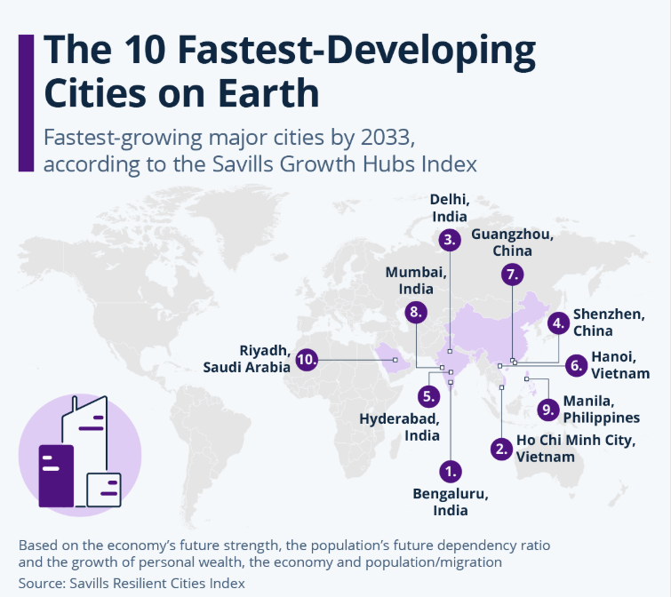
Fastest Developing Cities on Earth

Slide 8
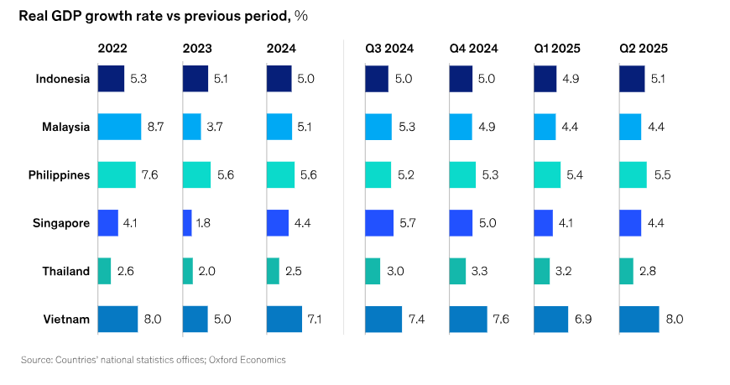
SOUTHEAST ASIA GDP GROWTH

Slide 9
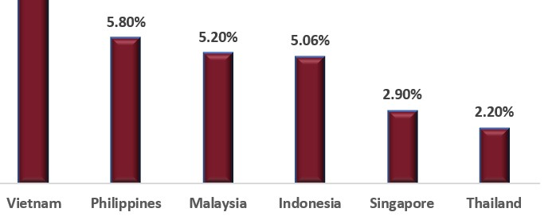
SOUTHEAST ASIA GDP GROWTH

Slide 10

Vietnam’s Deep International Integration
Vietnam - Japan
Effective
Vietnam - Chile
In negotiation/ Negotiation concluded
Vietnam - Korea
ATIGA
Vietnam – Eurasian Economic Union
ASEAN - China
ASEAN - Korea
Vietnam - EU
ASEAN - India
Vietnam - EFTA
ASEAN – Australia – New Zealand
CPTPP
ASEAN - Japan
ASEAN – Hong Kong
RCEP
Vietnam - Israel
Vietnam - UAE
Vietnam - UK

Slide 11
Vietnam’s Deep International Integration (cont.)
Vietnam has negotiated, signed and put into effect a number of bilateral and multi-lateral FTAs with almost all the big economies in the world.
17 FTAs involving more than 60 partners have become effective, covering all continents with a combined GDP accounting for nearly 90 percent of global GDP, making Viet Nam one of the countries in the region taking the lead in joining bilateral and multilateral economic cooperation frameworks.

Slide 12
Vietnam’s Deep International Integration (cont.)
Four years after the effectiveness of EU-Vietnam Free Trade agreement (1 August 2020):
Vietnam's exports to the EU have increased by almost 50%, while its imports from the EU have increased by more than 40%.
The General Department of Vietnam Customs (GDVC) reports that the volume of two-way trade in 2023 was US$296.87 billion due to the effectiveness of the EU-Vietnam Free Trade agreement . Vietnam's exports to the EU reached over US$24.69 billion in the first half of 2024, according to GDVC, a 15.37% yearly rise.
Without the EU-VN Investment Protection Agreement being effective, from the effective date of the EUVNFTA, EU members have invested €28 billion (US$30.6 billion) in 2,450 projects in Vietnam, many of which are high-quality investments in high-tech manufacturing and services.

Slide 13
EVFTA AND EVIPA
The EVFTA is a new generation free trade agreement between Vietnam and 27 EU member countries
On 2nd December 2015, both Vietnam and the EU concluded the negotiations.
On 26 June 2018, the EVFTA was divided into 2 agreements in terms of trade and investment following the European Court of Justice’s opinion on the EU – Singapore FTA
The EVFTA covers trade issues while investment protection and investment-related dispute settlement are under the EVIPA.
On 30 June 2020, the EVFTA and the EVIPA were signed in Hanoi.
EVFTA takes effect from 01 August 2020.
By August 2024, there have been 18 out of 27 EU member states. Some countries, including Ireland, Austria, Poland, Belgium, Germany, France, Cyprus, the Netherlands, and Slovenia, are still pending ratification.

Slide 14
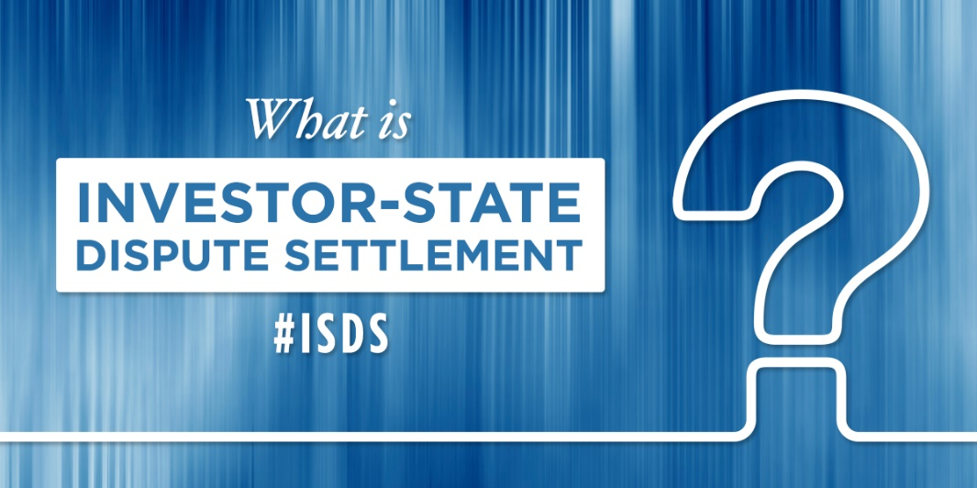
EVIPA
EVIPA applies to the investments under the EVFTA.
Investment protection.
Investor-to-State dispute settlement mechanism (“ISDS”) whereby investors can claim in case that an investor protection obligation has been breached and domestic courts cannot question the legal validity of the decisions.
EVIPA will replace all bilateral investment agreements between Vietnam and other EU members.

Slide 15
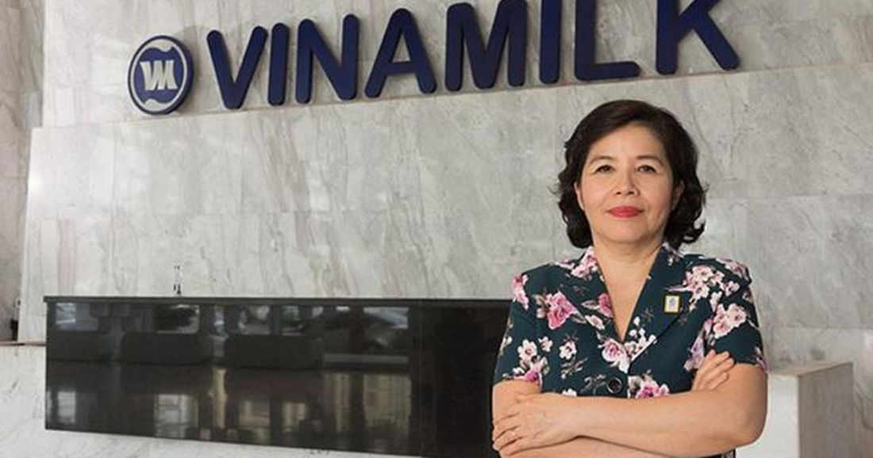


Female Business Ownership – Women Power
Vietnamese women now lead 22 per cent of all enterprises in Vietnam, a level comparable to that in developed countries, such as Sweden (20 per cent), Singapore (24 per cent), and France (24 per cent)
According to the Ministry of Finance, a fifth of Vietnam’s small- and medium-sized enterprises (SMEs) are women-owned. The figure is on par with strongly developed economies in the region such as Singapore, Thailand, and Indonesia, and even with nations further afield such as France and Sweden.
Currently, Vietnam is one of the most developed markets for female entrepreneurs and has the most effective female business network in ASEAN.

Slide 16
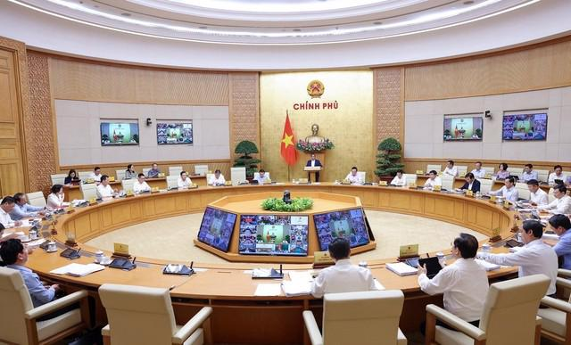
Political Stability
According to Best Diplomats, a New York-based organization, Vietnam ranked 8th in the list of 10 safest countries in Asia thanks to Vietnam’s low crime rates, political stability, and secure environment. Best Diplomats further hailed Vietnam for its beauty, rich culture, and delicious cuisine.
According to World Bank, Vietnam’s data shows that Vietnam is one of the most stable countries in terms of political stability and absence of violence/terrorism.

Slide 17
The private sector at the heart of the development
Recently, a groundbreaking Resolution 68 was issued to direct the development of Vietnam until 2045, with key takeaways:
The role of the private sector: Resolution 68 formally elevates the role of private enterprise, acknowledging it as a foundational component of Vietnam’s socio-economic development strategy, rather than a supplementary force.
Market Access and Business Activities: Enterprises are granted the right to engage in all business sectors not explicitly banned or prohibited by the laws, with any restriction required to be based on legal, transparent, and public interest justifications rather than arbitrarily applied. This new perception should remove the long-rooted “ask-give” mechanism commonly adopted by competent authorities.

Slide 18
Virtual assets in Vietnam
The National Assembly passed the groundbreaking Law on Digital Technology Industry recently, making Vietnam the first country ever to pass a law regulating digital technology
Virtual assets: Virtual assets are now officially legalized and recognized.
Crypto assets vs. virtual assets: The new law introduces separate concepts for crypto assets and virtual assets.
Sandbox mechanism for virtual assets products and virtual assets service providers: The new law established a pilot sandbox mechanism for virtual assets products and services, including a mechanism to exclude liability for participating State agencies, businesses, and individuals.

Slide 19
High-growth economy plus potential market
WTO analysis of liberalization of market access
Country | Limitation of market access* | Country | Limitation of market access*
Malaysia | medium | Myanmar | high
Indonesia | medium | Cambodia | medium
Philippines | medium | Laos | medium
Singapore | low | India | high
Thailand | medium | China | medium
Brunei | high | Vietnam | low
* Typical restrictions: number of opened sectors, JV requirement, limits on foreign-owned shares, permission requirement
Copyright Oliver Massmann - All rights reserved

Slide 20
Vietnam’s Competitive Labor Cost
Vietnam has a young population and a potential workforce. Remarkably, the country’s average wage cost is more competitive than the neighboring countries like China.
According to statistics, the manufacturing labor cost per hour in China was US$6.5, while in Vietnam the cost is only around US$3, half as much as that of China.
60% of Vietnam’s population are working age (about 60 million).

Slide 21
Vietnam’s Political Strength
Political Stability: No regional, religious or ethnic conflicts.
Strategic Ally: Vietnam’s role in countering China’s rise aligns with US interests, bolstered by shared South China Sea concerns.
Flexible Bamboo Policy: Diplomatic adaptability - resilient yet pragmatic - ensures stability amid geopolitical shifts, outpacing other ASEAN countries

Slide 22
Vietnam can escape middle-income trap
Vietnam has two significant sources of growth to escape the middle-income trap:
From outside in: The ongoing shift in global supply chains is drawing more technology and industrial sectors to Vietnam. The country is rapidly climbing the value chain and becoming a preferred location for products with deeper manufacturing complexity.
From inside out: A growing middle class is fueling domestic consumption, which already accounts for around 55% of GDP—one of the highest rates in Southeast Asia. The government has recognized digitalization as a key driver of efficiency and is planning to expand this process systematically at the administrative level. The proposed reduction of provinces from 63 to 34 marks a major step and sends a clear signal about the direction ahead.

Slide 23
Vietnam can escape middle-income trap
With all of its advantages, Vietnam is expected to soon escape the middle-income trap as soon as the following actions are taken:
Institutional reforms
Adaptation to climate change in terms of the legal framework and policies
Administrative reforms by ways of reducing administrative burden
Better coordination across local competent authorities

Slide 24
DOING BUSINESS AND INVESTING IN VIETNAM

Slide 25
Investment environment in Vietnam
Main governing laws: 2020 Investment Law, 2020 Enterprise Law and their amendments and implementing documents
Forms of doing investment in Vietnam:
Economic entity establishment;
Business cooperation contract: a contractual arrangement between two or more investors without creating a legal entity
Public-Private Partnership; a contractual agreement between competent state authorities and investors, an enterprise project in order to implement an investment project;
purchase of shares or capital contribution.

Slide 26
Investment environment in Vietnam
Forms of enterprises in Vietnam
Limited liability company: members are liable to the extent of their capital contributed
Shareholding Company: charter capital (authorized share capital) is divided into shares and members are liable to the extent of their capital contributed
Partnership: established between two or more partners;
Business Cooperation Contract: an agreement without constituting a legal entity and each party is individually responsible for paying taxes.
Branch: a branch of a foreign company permitted to conduct commercial activities
Representative Office: represents the parent company, no actual business operations. A suitable tool for market research

Slide 27
Investment procedure under 2020 Investment Law
Under the Investment Law and Enterprise Law: 2 separate steps - Application for Investment Registration Certificate (“IRC”) and Application for Enterprise Registration Certificate (“ERC”)
Step 1: IRC
IRCs for projects required to obtain preliminary approval of the National Assembly/ People’s Committee are issued within 05 working days upon issuance of such approval
For other projects, IRCs are issued within 15 days upon receipt of the application dossier
Step 2: ERC
Submit an application dossier to the licensing authority upon issuance of the IRC
ERCs are issued within 03 working days upon receipt of the application dossier

Slide 28

How to get deals done
Conduct a careful Due Diligence
(including legal and financial)
Make sure all business lines of the target entity are transferred to the new entity upon the deal completion (non-conditional business sectors and conditional business sectors)
Note that M&A activities are administered by the Department of Finance and dossiers are subject to very strict examination

Slide 29
INVESTMENT INCENTIVES
Item | Standard Rate | Maximum Incentive
CIT Rate | 20% | 10% (for up to 15 years, in some cases, for the entire project life)
Tax Holiday | None | 4 years
Tax Reduction | None | 9 years
Conditions to enjoy incentives:
Technology R&D: Projects involving high technology, R&D, and Software Production
Encouraged Sectors: Education, Healthcare, Infrastructure, Renewable Energy, Supporting Industries
Location: Projects in extremely difficult socio-economic conditions or designated hi-tech zones/economic zones
Large-sized projects: Large-sized manufacturing projects with significant capital investment or high employee counts.

Slide 30
Personal Income Tax
For foreigners being resident individuals:
being present in Vietnam for 183 days or more in one calendar year or in 12 consecutive months from the first day of entry within Vietnam; or
having a permanent residence in Vietnam, including a place to live under permanent residence registration or a rented house in Vietnam under a term lease
income tax regime is applied for income from business, salaries and wages with rates specified by Partial Progressive Tariff in article 7.2 of the Circular 111/2013/TT-BTC
For foreigners being NON-resident individuals:
Income from business activities: 1% for goods trading; 5% for the service business; and 2% for production, construction, transportation and other business activities
Income from salaries and wages: tax rate is 20% of taxable incomes from salaries and wages

Slide 31
Taxation in Vietnam
Value-added Tax (“VAT”)
Tax applied to goods and services used for production, trading and consumption in Vietnam (including goods and services purchased from abroad)
Tax rate: 0-10% depending on types of goods and services
Other taxes: special sales tax (applied to luxury goods or amusement places), natural resources tax, land and housing tax, etc.

Slide 32
Choosing your legal advisor

Slide 33
How to choose your legal advisor
Choosing your legal advisor: You must be able to hold your legal advisor fully responsible and accountable for their work and advice! Pay attention to the engagement letter for legal services to see whether your legal advisor has unlimited professional liability! When it is capped, it is a no-go!

Slide 34
THE SECRET OF VIETNAMS ECONOMIC SUCCESS:
PRAGMATISM OF ITS PEOPLE
WOMEN POWER
INTERNATIONAL INTEGRATION

Slide 35
CONNECTIONS ARE BUSINESS PLEASE CONNECT WITH ME ON LINKEDIN: OLIVER MASSMANN

Slide 36
DUANE MORRIS VIETNAM LLC
Thank you very much!
HANOI OFFICE HO CHI MINH CITY OFFICE
Pacific Place, Unit V1307/08, 13th Floor, Suite 1503/04, Saigon Tower
83B Ly Thuong Kiet, Hoan Kiem District 29 Le Duan Street, District 1
Hanoi, Vietnam Ho Chi Minh City, Vietnam
Tel.: +84 24 3946 2200 Tel.: +84 28 3824 0240
Fax: +84 24 3946 1311 Fax: +84 28 3824 0241
Contact email:
omassmann@duanemorris.com

