Slide 1
VIETNAM - MARKET ENTRY –
IN CONTEXT OF ASIA
DR. OLIVER MASSMANN - PARTNER, GENERAL DIRECTOR
DUANE MORRIS VIETNAM LLC

Slide 2
AGENDA
OVERVIEW OF VIETNAM BUSINESS LANDSCAPE
ASEAN, EU- Vietnam Free Trade Agreement (“EVFTA”), EU- Vietnam Investment Protection Agreement (“IPA”) and the Comprehensive and Progressive Trans-Pacific Partnership (“CPTPP”)
  WHAT ARE THEY?
  What do they have to offer?
  How can foreign investors take advantage of these agreements?

Slide 3
Overview of Vietnam business landscape

Slide 4
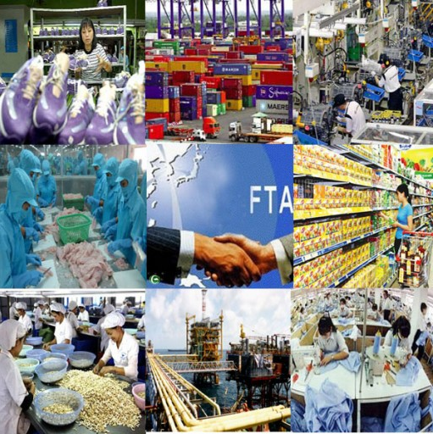
Vietnam Economy at a glance
  2024 GDP: US$476.3 billion
  GDP per capita: US$4,700
  GDP Growth in 2024 increased by 7%
  Inflation: 3.63%
  Population: About 101 million
  Labor force aged 15 and above: 68.9%
  Regional Minimum wage (Region I): VND 4,960,000 (US$ 198) per month (effective from 1st July 2024)
  Vietnam’s median age: 32.8 years old
  Recently, FTSE Russell announced that Vietnam will be upgraded to Secondary Emerging Market status from 21 September 2026, after a final review scheduled for March 2026.

Slide 5

Emerging Market Status
  Taking the US pension funds for example:
  Based on the available data on retirement assets, the total capital of the US pension funds is about $30 trillion
  US pension funds often invest in international stocks via passive funds or active mandates tied to global equity benchmarks provided by index like MSCI or FTSE Russell
  If Vietnam achieves Emerging Market status, it will be significantly easier and more automatic for US pension funds to invest in Vietnam compared to its current frontier market status.
  -> Potential inflows of billions of US Dollars from passive funds alone is underway for Vietnam.

Slide 6
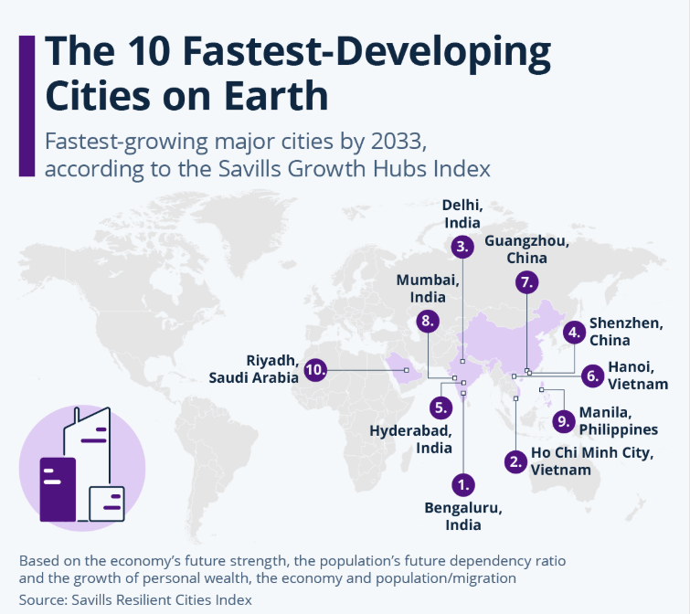
Fastest Developing Cities on Earth

Slide 7
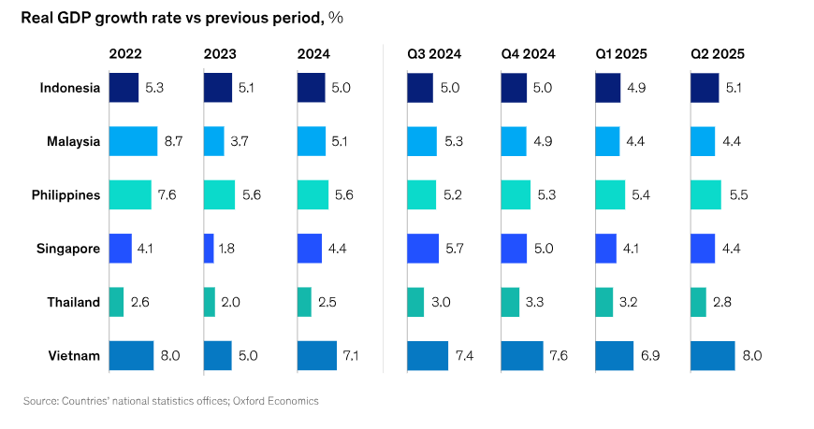
SOUTHEAST ASIA GDP GROWTH

Slide 8
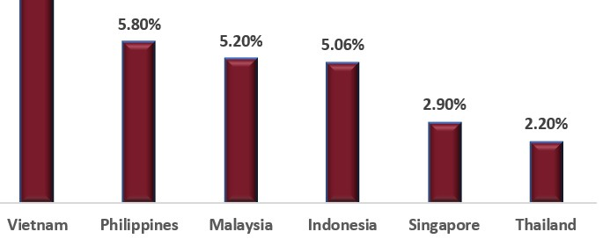
SOUTHEAST ASIA GDP GROWTH

Slide 9
High-growth economy plus potential market
WTO analysis of liberalization of market access
Country | Limitation of market access* | Country | Limitation of market access*
Malaysia | medium | Myanmar | high
Indonesia | medium | Cambodia | medium
Philippines | medium | Laos | medium
Singapore | low | India | high
Thailand | medium | China | medium
Brunei | high | Vietnam | low
* Typical restrictions: number of opened sectors, JV requirement, limits on foreign-owned shares, permission requirement
Copyright Oliver Massmann - All rights reserved

Slide 10

Vietnam’s Deep International Integration
Vietnam - Japan
Effective
Vietnam - Chile
In negotiation/ Negotiation concluded
Vietnam - Korea
ATIGA
Vietnam – Eurasian Economic Union
ASEAN - China
ASEAN - Korea
Vietnam - EU
ASEAN - India
Vietnam - EFTA
ASEAN – Australia – New Zealand
CPTPP
ASEAN - Japan
ASEAN – Hong Kong
RCEP
Vietnam - Israel
Vietnam - UAE
Vietnam - UK

Slide 11
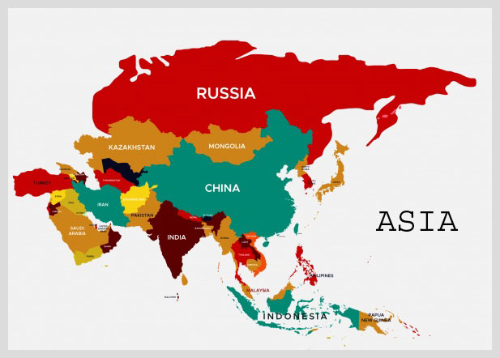
In the context of Asia
Vietnam has executed high-standard, new-generation FTAs compared to its peers in Asia
High foreign direct investment inflows compared to developed countries in the region
Vietnam has committed near-zero tariffs for key markets (i.e., EVFTA)
-> Vietnam is unmatched when it comes to market entry and limitation of market access.

Slide 12
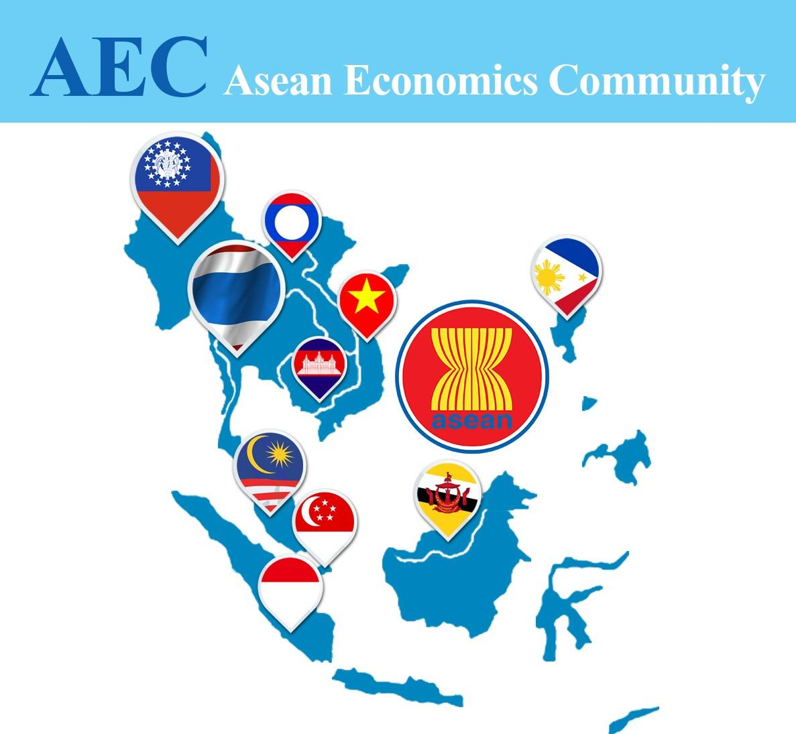

Slide 13
AEC Market Snapshot – Asia’s main investment hub
Population: 683 million, median age ~30.3 years
AEC % of world GDP: ~6.5%
AEC % of world population: ~8.5%
AEC’s merchandise exports: US$1.81 trillion
Fourth largest exporting region in the world

Slide 14
AEC - Services sectors of priority integration
Air travel
e-ASEAN
Healthcare
Tourism
Logistics services

Slide 15
AEC Mutual recognition arrangement
To facilitate the free flow of professional services
Professional service providers registered/certified in their home countries to be equally recognized in other signatory countries
Up to now, 8 mutual recognition arrangements on:
  Engineering services
  Nursing services
  Architectural services
  Surveying qualifications
  Accountancy services
  Medical practitioners
  Dental practitioners
  Tourism professionals
  E.g.: a certified practicing Indonesian doctor will then be allowed to practice in Vietnam

Slide 16
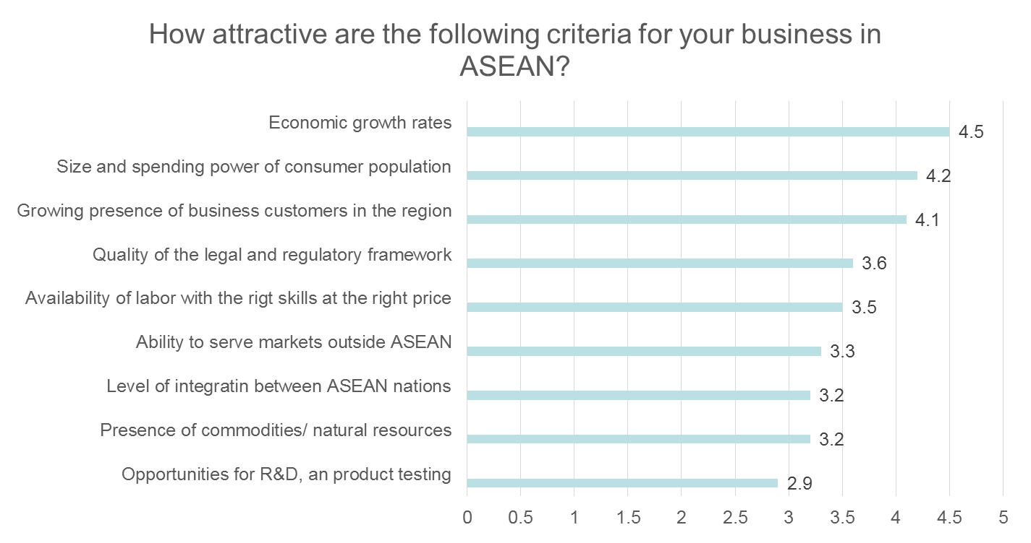
Why doing business in ASEAN – Investors’ perspective
Source: Economic Corporate Network

Slide 17
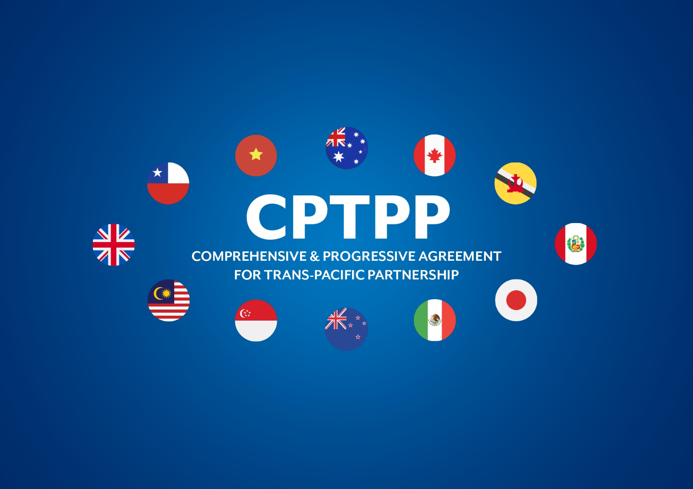

Slide 18
Comprehensive and Progressive Trans-Pacific Partnership (“CPTPP”)
On 8 March 2018, the CPTPP was finally signed in Chile. At the time of signing, the CPTPP accounts for 495 million people representing 13.5% of the world total economic output - worth a total of $10 trillion.
Vietnam will have access to newer markets and can expand their exports to countries such as Canada, Mexico, and Peru with whom it does not have a trade agreement.
Opportunity for Vietnam to re-structure the export market portfolio, not rely too much on the United States.

Slide 19

















CPTPP and AEC intersection
AEC
CPTPP
Australia
Canada
Malaysia
Brunei
Thailand
Cambodia
Peru
Japan
Singapore
Indonesia
Myanmar
Mexico
New Zealand
Vietnam
Philippines
Laos
Chile

Slide 20
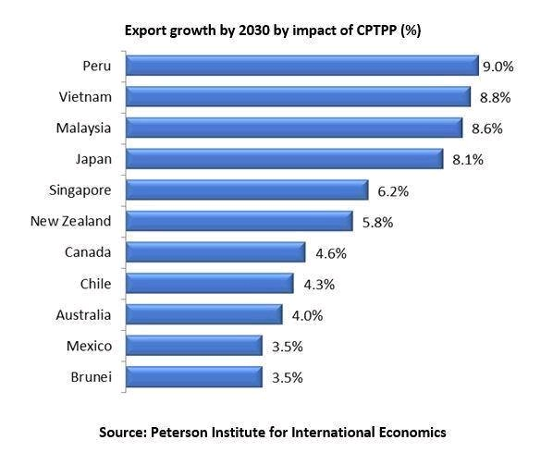

Slide 21
CPTPP - Gains for Vietnam
Sectors that benefit the most from the CPTPP:
  Textiles, clothing, footwear
  Food, beverages and tobacco
  Chemicals, transport equipment, plastic parts

Slide 22
CPTPP - Gains for Vietnam (cont.)
Opportunity to involve in new supply chain in the region given strict Rules of Origin
More incentives for Government institutional and economic reforms towards more transparent, open and predictable investment environment, attracting more foreign investment in Vietnam
More sophisticated joining of separate business sections to integrate into new profit streams

Slide 23


CPTPP - Challenges for business in Vietnam
Weak supporting industry
Stagnation of the enterprise system
Role of SOEs in the system
Level of IP protection
Corruption

Slide 24
EU – Vietnam Free Trade Agreement (EVFTA)

Slide 25
EVFTA AND IPA
On 26 June 2018, the EVFTA was divided into 2 agreements in terms of trade and investment following the European Court of Justice’s opinion on the EU – Singapore FTA
The EVFTA will cover trade issues while investment protection and investment-related dispute settlement will be under the IPA.
On 30 June 2020, the EVFTA and the EVIPA were signed in Hanoi.
EVFTA takes effect from 01 August 2020.
By August 2024, there have been 18 out of 27 EU member states. Some countries, including Ireland, Austria, Poland, Belgium, Germany, France, Cyprus, the Netherlands, and Slovenia, are still pending ratification.

Slide 26
EVFTA – Comprehensive agreement
Cross-cutting issues
Dispute Settlement
Government Procurement
State Owned Enterprises & Subsidies
Intellectual Property Rights
Geographical Indications
Trade and Sustainable Development
Cooperation and Capacity building
Annexes (car; green tech and pharma)
Trade in goods
Market access for goods – tariffs
Rules of Origin
Export duties
Technical Barriers to Trade (TBT)
Sanitary and Phytosanitary Measures
Customs and Trade Facilitation
Administrative Cooperation in Customs Matters
Services and investment:
E-commerce/ Renewable energy generation
Liberalisation commitments / market access

Slide 27
EVIPA
Applies to covered investment and its investors
“Investment” means every kind of asset which is owned or controlled, directly or indirectly, by an investor of EU/ Vietnam in the territory of Vietnam/ EU, which has the characteristics of an investment (for example, commitment of capital or other resources, the expectation of gain or profit, the assumption of risk and a certain duration).
Investment protection
Investor-to-State dispute settlement mechanism (“ISDS”)
EVIPA will replace all bilateral investment agreements between Vietnam and other EU members

Slide 28
EVFTA – Main features
Symmetrical elimination of nearly all tariffs (over 99%)
Removal of almost all export duties and cap on remaining ones
Services commitments going beyond GATS

Slide 29
EVFTA – Tariff Liberalization
Tariff liberlization:
  99% of tariffs both value and number of tariff lines
  After 7 years for EU
  Vietnam 10 years
  Coverage at entry into force:
  71% of value of Vietnamese exports / 84% tariff lines
  65% value of EU exports / 49% tariff lines

Slide 30
EVFTA – Benefits for Vietnam
Vietnam’s annual economic expansions rate may grow an additional 15% every year
Tariffs for most of Vietnamese export product to the EU will gradually reduce to 0%
The real wages of skilled laborers may increase by up to 12% while real salary of common workers may rise by 13%
The EVFTA is the legal framework for a more stable relationship in bilateral trade for Vietnam when competing in the international market
The EVFTA will generate greater effects, e.g. increased quality of investment flows from EU, acceleration of the process of sharing expertise and transfer of green technology and the creation of more employment activities

Slide 31
EVFTA – Benefits for the European Union
23 of the 27 member states of the EU (UK not included) are trade partners of Vietnam
Improvement of intellectual property rights
Higher level of security over EU’s investment in Vietnam
Better access to EU’s second important trading partner in ASEAN

Slide 32
Government Procurement
Average government procurement in the EU is about 16%
Vietnam has one of the highest government procurement rates of all countries worldwide (with about 39%)
Vietnam is not a member of the Government Procurement Agreement of the WTO
Vietnam undertakes to transparency and procedural fairness regulations
Investors will get access to a huge market of government procurement

Slide 33
IPA - Conflict Resolution
IPA secures a modern reformed investment dispute resolution standard
A standing international and fully independent investment tribunal will be competent to all conflicts about investment protection provisions (5 year transitional period for Vietnam)
UNCITRAL rules on transparency in treaty-based investor-state arbitration are implemented which guarantees a high standard of juridical transparency
The decisions of the tribunal are enforceable and cannot be questioned by local jurisdiction

Slide 34
Opportunities and challenges in some specific sectors

Slide 35

Automotive
Almost fully liberalization of EU machinery and appliances exports
EU exported car parts will be duty free after seven years
Cars and motorcycles will be duty free after ten years
3 years after the FTA comes into effect, Vietnam will accept UNECE (standards adopted from the EU, U.S., Russia and many other states which settle e.g. Worldwide harmonized Light vehicle Test Procedures) certification without any further testing requirements
Demand for automobiles in Vietnam is at no other time set to surge like this moment
Vietnam is going to be the new production hub in Asia for the machinery and especially automotive tier two manufacturing industry where several German and European automotive companies already experienced their own success story

Slide 36

Pharmaceutical Products
Improvement of intellectual property right
Simplification of marketing authorization
Centralized procurement system for pharmaceuticals which will legally secure market access

Slide 37

Alcoholic Beverages
Geographical Indications will be better protected
Tariffs for alcoholics will be reduced after 7 or 10 years
Vietnam removed /decreased restrictions in manufacturing of beverages

Slide 38
Challenges
As the market will be much more open, a high level of competitiveness will reach Vietnam’s companies
Especially the sellers of electrical products, cars, motorcycles and machinery will get to know a new level of business competition
The challenge will be to maintain and improve the standards of labor rights, environmental protection and sustainability even though the price pressure will increase
The income from tariffs will be reduced

Slide 39
Impacts
EVFTA and IPA will make trading more transparent and competitive
It will be much easier for investors to access new markets in Vietnam
A high quality standard is settled
Intellectual property will be safer

Slide 40
CONNECTIONS ARE BUSINESS
PLEASE CONNECT WITH ME ON LINKEDIN:
OLIVER MASSMANN

Slide 41
DUANE MORRIS VIETNAM LLC
Thank you very much!
HANOI OFFICE HO CHI MINH CITY OFFICE
Pacific Place, Unit V1307/08, 13th Floor, Suite 1503/04, Saigon Tower
83B Ly Thuong Kiet, Hoan Kiem District 29 Le Duan Street, District 1
Hanoi, Vietnam Ho Chi Minh City, Vietnam
Tel.: +84 24 3946 2200 Tel.: +84 28 3824 0240
Fax: +84 24 3946 1311 Fax: +84 28 3824 0241
Contact email:
omassmann@duanemorris.com

