Slide 1
Humans are Underrated: Why Artificial Intelligence Will Never Replace Humans Judgement
DR. OLIVER MASSMANN - Partner, General Director
DUANE MORRIS VIETNAM LLC

Slide 2
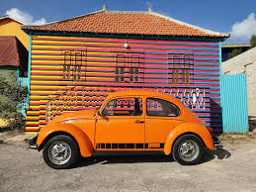

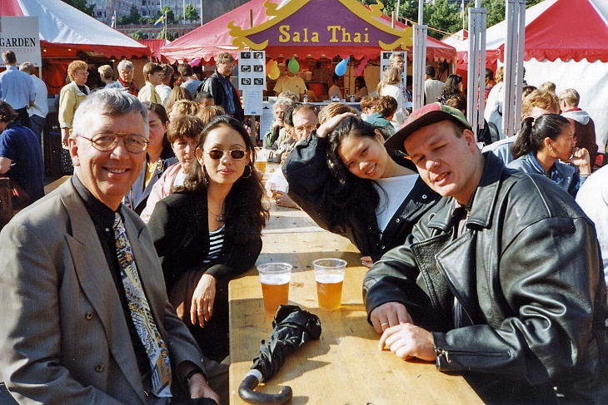
I was 18 years old…
… sitting in a Volkswagen Käfer, feeling the cold, uncertainty, youth
Somewhere near the inner German border
I had a paper map. Folded badly. And I wasn’t sure I was on the right road. Honestly, I didn’t really know what would happen when I got there. No safety net. There was no system helping me. No GPS! No assistant! Just me … making decisions.
Fast forward to today!

Slide 3
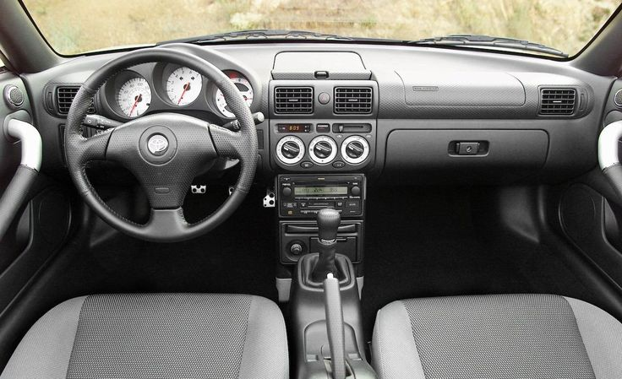
Now…
I sit in a car that tells me:
  The speed limit
  The distance to the next car
  Even when I make a mistake
  Sometimes, it drives better than I do.
  So, if machines are becoming better at driving, better at thinking, better at deciding, WHAT IS LEFT FOR US?

Slide 4

For a long time, we believed something simple: If you are intelligent, you will always be valuable
That belief is now breaking.
Today, machines can:
  write contracts
  diagnose diseases
  analyze markets
Not perfectly, but often good enough. And here is the uncomfortable truth.
Anything that can be turned into a process will eventually be done by a machine.
In classical Vietnamese strategy, victory does not belong to the strongest, but to the one who understands the situation best.
Strategy is not about force. It is about perception… timing… and positioning.

Slide 5
Vietnam’s experience
When I first came to Vietnam in the early 90s, heat, noise, movement, … nothing was standardized. No clear rules. No clear answers. You couldn’t rely on systems.
You had to rely on people.
And that’s where I learned something I didn’t fully understand at the time: Facts don’t move things forward. People do.
In Vietnam, there is a women power. Women move things, and get things done.
In fact, about 30% of all private businesses in Vietnam are run by women as CEOs or in top management.
You can have the perfect legal argument and still lose. Or you understand the other side, and suddenly everything moves.
What is said… is not always what is meant. And what is meant… is what matters.

Slide 6
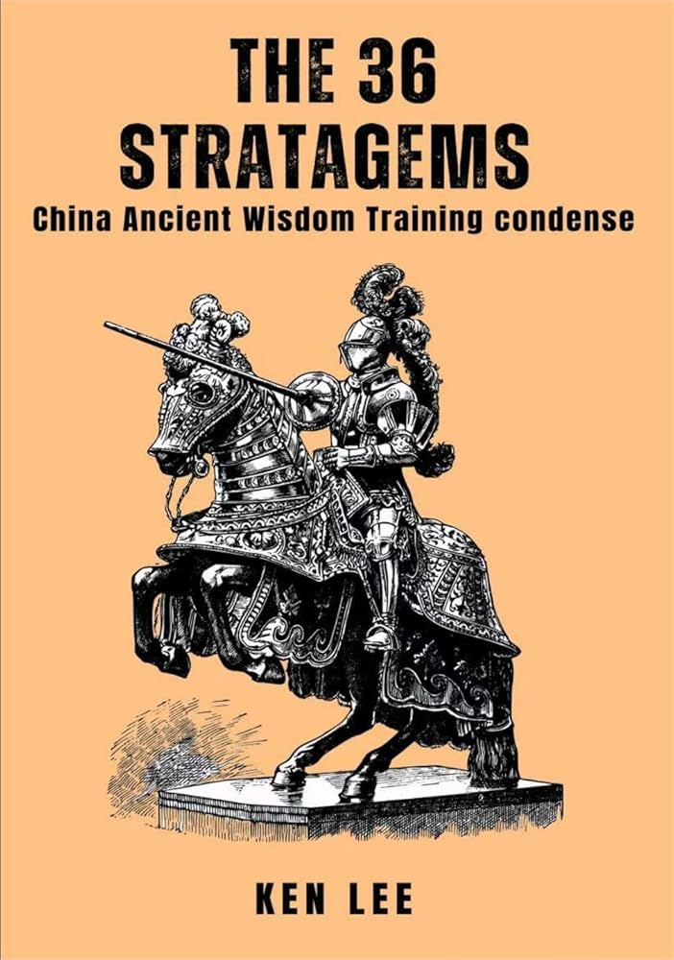
Stratagem Thinking
  This is where strategy begins.
  Make a feint to the east while attacking in the west. This is not logic. This is understanding perception.
  A machine executes a plan. A human changes the game.
  Strategy is not calculation. It is interpretation.

Slide 7
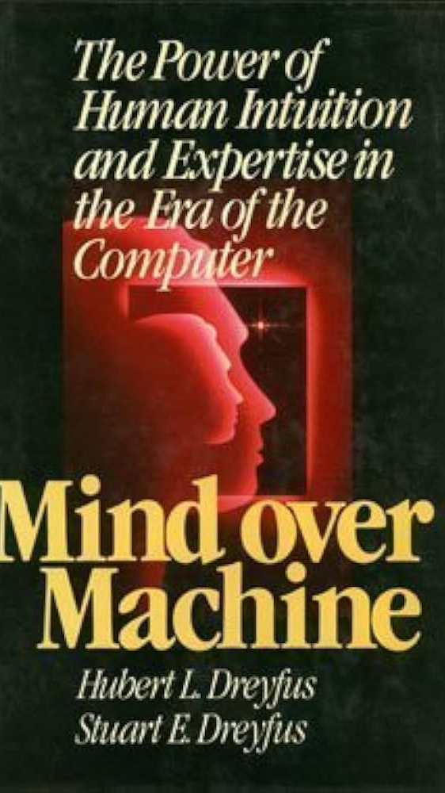
Human Advantage
  A machine sees data. A human sees meaning.
  A machine processes information. A human builds trust.
  A machine follows rules. A human navigates uncertainty.
  A machine gives answers. A human creates conviction.

Slide 8
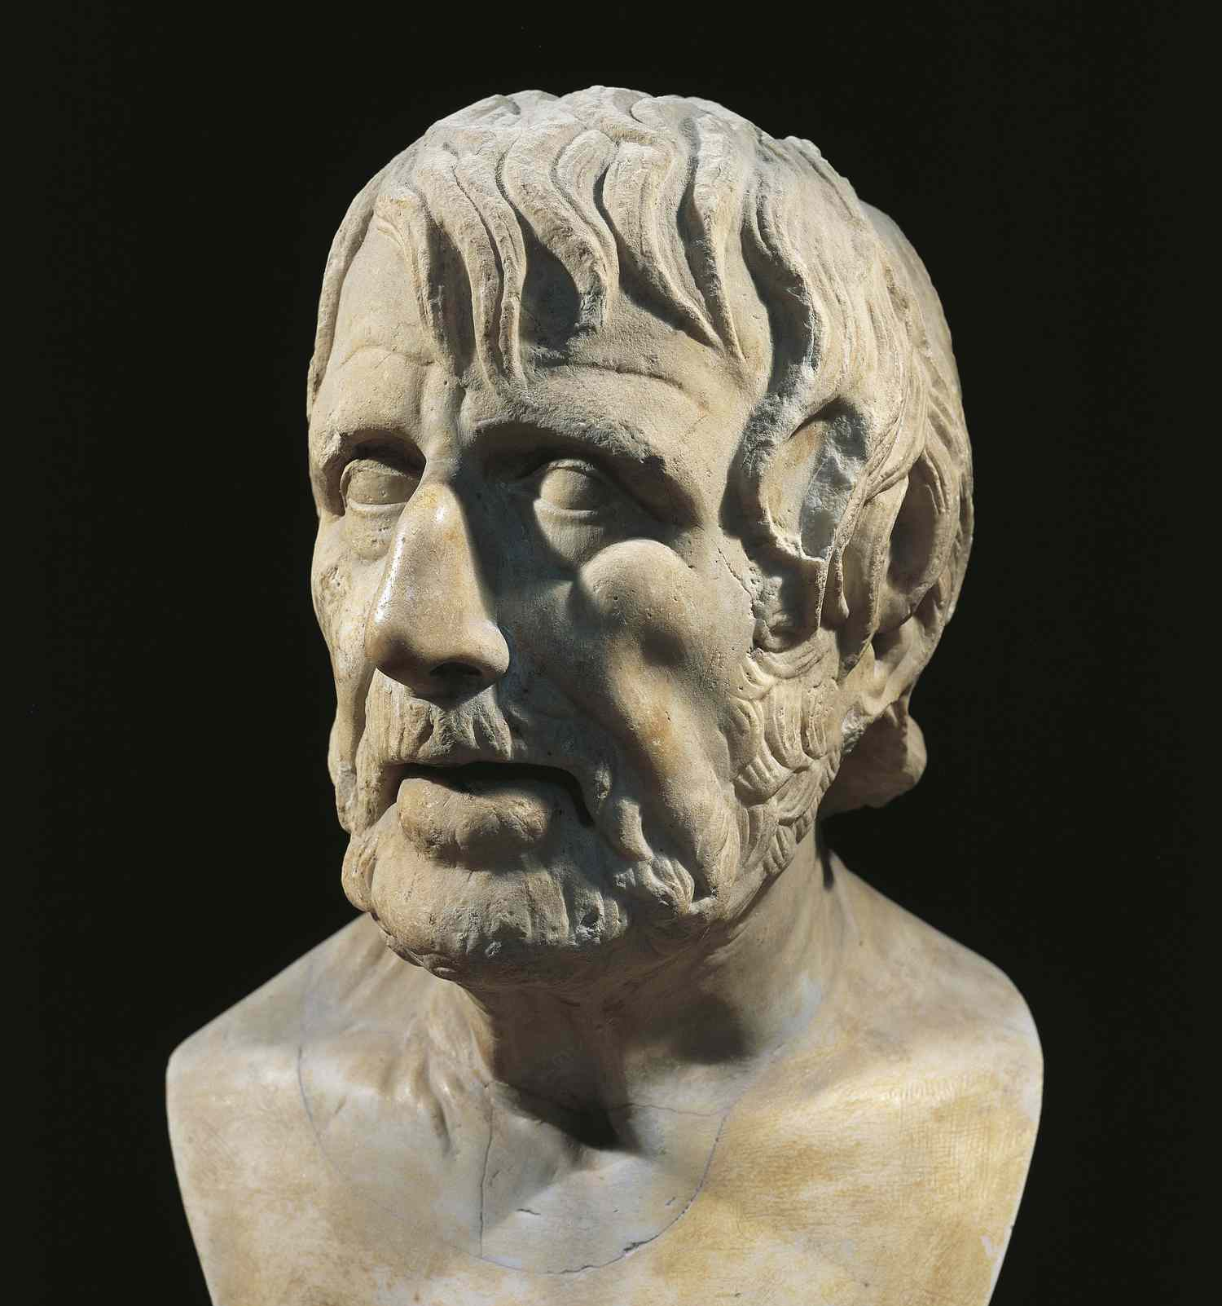
Seneca
  But strategy without inner stability is dangerous.
  Seneca wrote:
  We suffer more often in imagination than in reality
  Fear of AI… Fear of irrelevance. Most of it… is imagined.
  In a world of speed, the real advantage is not speed. It is clarity.
  That’s why my Vietnamese name is Gia Minh - the one who brings clarity.

Slide 9
So, what do we have?
  Machines give us efficiency.
  Strategy gives us advantage.
  Character gives us direction
  The future belongs to those who combine all three.
  When I drove that Kaefer, I had no system.
  When I worked in Vietnam, I had no certainty.
  Today we have too much of both. But what worked then still works now:
    Understanding people
    Reading situations
    Staying calm under uncertainty

Slide 10

Closing
  Machines will continue to improve. That is certain.
  But they will never build trust, understand context, or truly care.
  We are not becoming obsolete. We are becoming… more human.
  The future will not be decided by those who think fastest, but by those who understand deepest.

Slide 11
ME:
👉 “Built on experience. Multiplied by AI².”

Slide 12
CONNECTIONS ARE BUSINESS
PLEASE CONNECT WITH ME ON LINKEDIN:
OLIVER MASSMANN

Slide 13
WHEREVER YOU ARE - BE ALL THERE
Jim Elliot

Slide 14
DUANE MORRIS VIETNAM LLC
Thank you very much!
HANOI OFFICE HO CHI MINH CITY OFFICE
Pacific Place, Unit V1307/08, 13th Floor, Suite 1503/04, Saigon Tower
83B Ly Thuong Kiet, Cua Nam Ward 29 Le Duan Street, Sai Gon Ward
Hanoi, Vietnam Ho Chi Minh City, Vietnam
Tel.: +84 24 39462200 Tel.: +84 28 3824 0240
Fax: +84 24 3946 1311 Fax: +84 28 3824 0241
Contact email:
omassmann@duanemorris.com

